Slide 1
NCFE Level 1/2 Technical Award in Music Technology
Exam Revision Guide
Name: ………………………………………
Exam date: ………………………
Percentage of Final Grade: 40%

Slide 2
Revision Do’s:
Flashcards
Mind-maps
Look/cover/write/check
Revision question worksheets
Listen to mixes and evaluate them
Listen to songs and evaluate the use of musical elements
Give your knowledge organiser to someone else and ask them to quiz you
Revision Donts:
Just read stuff - you will not remember it
Just copy stuff down – you will not remember it
Only use one type of revision (e.g. flaschards) for one topic; a range of techniques helps your brain make stronger connections

Slide 3
Contents
Part One: Course Content Revision Guidance
Content Area 1: the Music Business & Music Technology…………………………1
Content Area 2: The Digital Audio Workstation (DAW)……………………………..2
Content Area 3: Musical Elements, Musical Styles & Music Technology……..3
Content Area 4: Sound Creation………………………………………………..………..4
Content Area 5: Multitrack Recording…………………………………………………..5
Part Two: Exam Technique & Revision Resources
1. Question Wording ……………………………………………………………………………….7
2. CA1 Revision Activities ……………………………………………………………………….. 9
3. CA2 Revision Activities ……………………………………………………….……………….14
4. CA3 Revision Activities ………………………………………………………………………. 20
5. CA4 Revision Activities ………………………………………………………………………. 34
6. CA5 Revision Activities ………………………………………………………………………. 39

Slide 4
Part One: Course Content Revision Guidance

Slide 5
Content Area 1: The Music Business & Music Technology
What am I likely to be asked?
To identify job roles
How music tech has developed over time
How to market & promote music
About music formats (e.g. vinyl), products, and distribution
About PRS & the Musician’s Union
How should I revise?
Flashcards on job roles
Look/cover/write/check music tech through time
Mind-map marketing & promotion
Music format revision questions
PRS/MU flashcards
Knowledge Organiser Pages: 2-8
Revise the topics in the table below. There are suggestions of how to revise directly above, but a range of revision techniques is best.
Each time you revise a topic, put a tick in the box next to it and update the RAG (red, amber, green), showing how confident you are with that topic.
 | Initial RAG | Tick | RAG | Tick | RAG | Tick | RAG
Job roles
Music tech through time
Marketing & promotion
Music formats, products & distribution
PRS & MU
1

Slide 6
Content Area 2: The Digital Audio Workstation (DAW)
What am I likely to be asked?
How hardware components work
About software functions including EQ, FX & dynamics processing
How to use a DAW
Health & safety
How should I revise?
Draw & label hardware & how it works
Answer software function questions
Answer How to Use a DAW questions
Mind-map health & safety
Knowledge Organiser Pages: 9-13
Exam technique: It is likely that you will be asked questions about specific pieces of hardware, e.g. XLR cables.
Activity: Complete diagrams showing how hardware connections & label how they work.
 | Initial RAG | Tick | RAG | Tick | RAG | Tick | RAG
Hardware components
Software functions
How to use a DAW
Health & safety
IMPORTANT
COMPLETE THE TICKBOX/RAG
2

Slide 7
Content Area 3: Musical Elements, Musical Style & Music Technology
What am I likely to be asked?
To identify & describe the use of the musical elements
To describe how different musical styles use the musical elements
To explain how technology influenced these styles
How should I revise?
Answer the musical elements questions
Listen to examples from each style & describe how they use the elements
Look/cover/write/check the technology associated with each style
Knowledge Organiser Pages: 14-23
Exam technique: It is highly likely that a big question will ask to describe the use of the musical elements in a piece of music.
Activity: Listen to recordings. How is each element of music used? How does each element change? Use keywords from the KO.
 | Initial RAG | Tick | RAG | Tick | RAG | Tick | RAG
Musical elements
Musical styles
Music technology
IMPORTANT
COMPLETE THE TICKBOX/RAG
3

Slide 8
Content Area 4: Sound Creation
What am I likely to be asked?
How sound is used in each form of media
How synths are used
How samplers are used
About arranging & exporting sounds
How should I revise?
Answer the Forms of Media questions
Mind-map synths
Mind-map samplers
Look/cover/write/check arranging & exporting sounds
Knowledge Organiser Pages: 24-27
Exam technique: The key thing here is understanding each form of media (e.g. theatre) and how sound is used for that form. You may be asked to evaluate different ways to create sound for media, e.g. props (foley), synthesis or samples.
Activity: Mind-map the benefits of different methods of sound creation.
 | Initial RAG | Tick | RAG | Tick | RAG | Tick | RAG
Forms of media
Synthesisers
Samplers
Arranging sounds
Exporting sounds
IMPORTANT
COMPLETE THE TICKBOX/RAG
4

Slide 9
Content Area 5: Multitrack Recording
What am I likely to be asked?
About all recording equipment
About health & safety
How to plan recording sessions
How to undertake recording
How to mix & export audio
How should I revise?
Answer the Forms of Media questions
Mind-map synths
Mind-map samplers
Look/cover/write/check arranging & exporting sounds
Knowledge Organiser Pages: 24-27
Exam technique: It is highly likely that your biggest question on the exam will be evaluating a mix.
Activity: Listen to recordings. How would you improve them? Which specific mixing techniques would you use and why?
IMPORTANT
 | Initial RAG | Tick | RAG | Tick | RAG | Tick | RAG
Forms of media
Synthesisers
Samplers
Arranging sounds
Exporting sounds
IMPORTANT
COMPLETE THE TICKBOX/RAG
5

Slide 10
Part Two: Exam Technique & Revision Resources
6

Slide 11
Question Wording
Different questions will use specific words that tell you how much depth to go into.
IT IS VERY IMPORTANT TO CHECK HOW MANY MARKS EACH QUESTION IS WORTH SO THAT YOU GO INTO THE CORRECT AMOUNT OF DETAIL.
1-mark question words:
Name
Give
Describe
Identify
How to answer: one word/short sentence
By the way: these might be combined to create questions worth more than 1 mark, e.g. name and describe
2-mark question words:
Explain
Assess
How to answer: 1 mark for identifying a correct answer + 1 mark for explaining why or how
By the way: YOU WILL OFTEN BE ASKED TO EXPLAIN 2 OR MORE THINGS IN ONE QUESTION, LEADING TO A TOTAL QUESTION SCORE OF 4, 6, OR 8.
BIG MARK QUESTIONS
Evaluate
Justify
Compare
Analyse
Reflect
Suggest
How to answer: Extended written answer in multiple paragraphs. 3 or 4 marks for recalling information. 3 or 4 marks for explaining how this information relates to the situation in the question. 3 or 4 marks for evaluating choices.
7

Slide 12
Part Two: Revision Activities
Working through these revision activities will ensure that you have at least revisited most of the content within the course.
Content Area 1: The Music Business and Music Technology
Key exam questions:
How key pieces of tech have developed
Marketing, promotion, distribution and PRS/MU
8

Slide 13
Content Area 1: the Music Business & Music Technology
1. It is likely you will be asked to identify job roles & describe what they do.
Write the different job roles, based on the responsibilities. (Also use FLASHCARDS)
Role | Responsibilities
Composer | Work to a brief; rehearse material; compose music
 | Work alongside composer; work to a brief; compose lyrics
 | Repair instruments; tune instruments
 | Control of studio session; creative input; coach artists
 | Similar to a composer except also write lyrics
 | Tune and maintain instrument; learn music quickly to perform on recordings
 | Take composed music and decide which instruments play what, and how.
 | Create/record sounds for film, TV, games etc.
 | Create playlists of recordings to perform in a venue /radio
 | Negotiate contracts; find opportunities for clients
 | Set up microphones & DAW projects; manage playback
 | Create marketing strategies; run promo campaigns; develop public image
 | Scout artists for labels; develop artists’ sound
2. You need to know the benefits of 2/4/8/16/24 track magnetic recording tape. Write them below
2-track tape
Decade popular: ……..…..
Benefits:
4 & 8-track tape
Decade popular: ……….…..
Benefits:
16 & 24-track tape
Decade popular: …………...
Benefits:
9

Slide 14
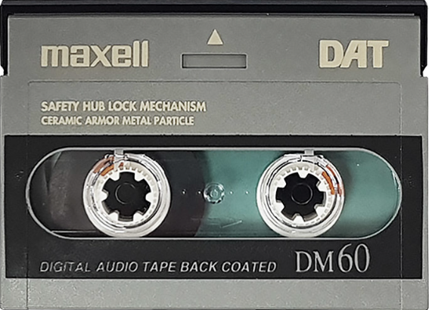


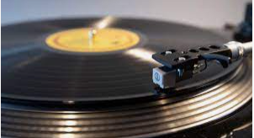
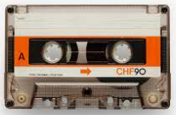





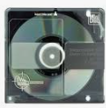
Content Area 1: the Music Business & Music Technology
3. This question is about DASH tape. Fill in the blanks.
Digital tape converts the incoming audio signal into a data stream of
……………. information (1s and 0s).
This is recorded onto the tape via the ……… ……... .
DASH can record ………. channels of audio to ……… inch tape or 24/48 channels to ½ inch tape.
Advantages: a) ………………………………… b) ……………………………………..
4. This question is about Alesis Digital Audio Tape. Fill in the blanks,
Magnetic 8-track tape. Uses the same S-VHS tape as a VCR.
You can …….. multiple ADATs together (up to 16), giving a total ……. possible tracks.
The ADAT HD24 replaced the original ADAT. This records …….. tracks to hard disk.
ADAT technology is still used in studios to ……………………………………… .
5. Consumer audio formats.
Label each consumer audio format.
Provide advantages and disadvantages
10

Slide 15
Content Area 1: the Music Business & Music Technology
6. Marketing. Create a mind-map for marketing:
What is it?
What is involved?
Why is it important?
Marketing
7. Promotion. (Extended written answer practice) Describe and evaluate the differences between physical and digital promotion methods. To do this, list different ways of promoting music. Then discuss the advantages and disadvantages.
Physical promotion: ………………………………………………………………………………..
…………………………………………………………………………………………………….....
……………………………………………………………………………………………………….
……………………………………………………………………………………………………….
…………………………………………………………………………………………………........
………………………………………………………………………………………………………..
……………………………………………………………………………………………………….
Digital promotion: ………………………………………………………………………………..
…………………………………………………………………………………………………….....
……………………………………………………………………………………………………….
……………………………………………………………………………………………………….
…………………………………………………………………………………………………........
………………………………………………………………………………………………………..
11

Slide 16



Content Area 1: the Music Business & Music Technology
8. Merchandise. Create a mind-map for merchandise:
Give examples of merch
Where might it be sold?
What makes it effective?
Merchandise
9. Physical distribution. Annotate the diagram to explain the process of getting physical copies of music to the shops..
Manufacturer
Distribution company
Retail
10. Digital distribution. Use the space below to explain how digital distribution services work.
……………………………………………………………………………………………………….
……………………………………………………………………………………………………….
…………………………………………………………………………………………………........
………………………………………………………………………………………………………..
……………………………………………………………………………………………………….
12

Slide 17
Content Area 1: the Music Business & Music Technology
11. PRS for Music. Circle or highlight the five true statements about PRS for Music
When a recording is played in public, a royalty is generated
PRS is a rapper from Chicago
PRS is a royalty collection and distribution service
PRS collect monies from artists
PRS collect monies from license-holders
Businesses that play music in public spaces do not need a license.
Businesses that play music in a public space must have a PRS license.
PRS distribute royalties to their rights-holders (artists)
PRS distribute royalties to their license-holders.
12. The Musician’s Union. In your own words, describe what the Musician’s Union does and what the benefits are of joining MU. You can write in full sentences, bullet points or complete a mind-map.
13

Slide 18
Content Area 2: The Digital Audio Workstation (DAW)
Key exam questions:
Identify specific pieces of kit, e.g. XLR cables & explain their uses
Synths and samplers
14

Slide 19
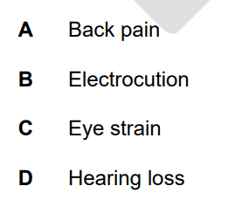

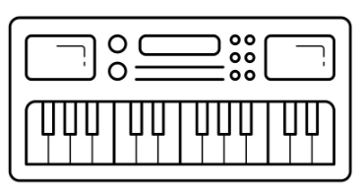

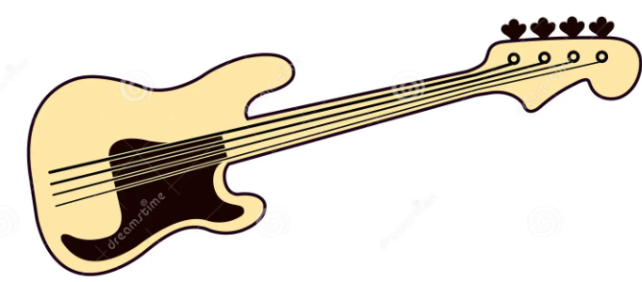
Content Area 2: The Digital Audio Workstation (DAW)
1. Health & safety will probably come up at some point. Below are some potential injuries. What could cause them and how could you prevent them?
2. It is likely you will be asked about connections (cables). In the space below, label how the MIDI keyboard, audio interface and bass guitar can be connected.(e.g. XLR cable).
3. At some point, they will probably ask you about different audio file types. In the space below, create a mind-map of uncompressed and compressed audio formats. Include examples, advantages and disadvantages.
Uncompressed audio
Compressed audio
15

Slide 20
Content Area 2: The Digital Audio Workstation (DAW)
4. Annotate the mind-map to explain the purpose of the computer hardware.
Cloud Storage
Network Drive
RAM
Operating system
Hard drive
Solid state drive (SSD)
Display
Universal Serial Bus (USB)
5. Use the keywords below to explain the function of MIDI controllers. Describe the features and provide advantages/disadvantages of using MIDI controllers over real instruments.
MIDI controllers
Guitar/keyboard/percussion/wind
Pitch
Velocity
Duration
USB
5-pin DIN cable
Pitch bend
Modulation wheel
Humanisation
……………………………………………………………………………………………..
………………………………………………………………………………………………
………………………………………………………………………………………………
………………………………………………………………………………………………
………………………………………………………………………………………………
………………………………………………………………………………………………
……………………………………………………………………………………………….
16

Slide 21
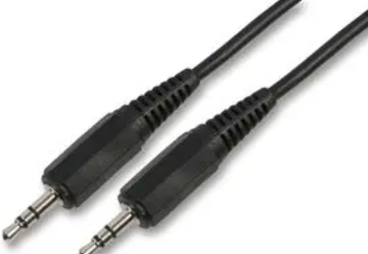
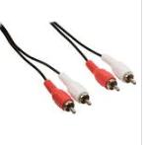
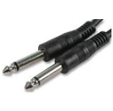
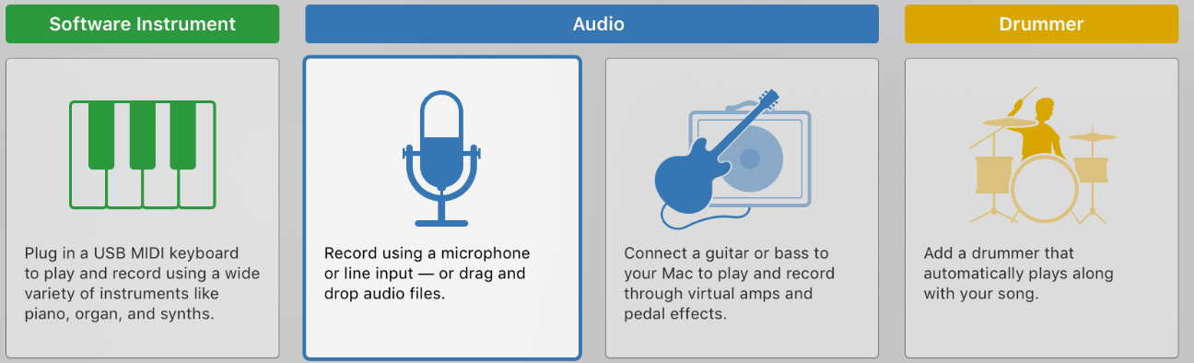
Content Area 2: The Digital Audio Workstation (DAW)
6. Connect the line input cable to the uses and the correct image.
RCA phono cable
Guitars and other instruments
¼” jack cable
Turntables/CD players
Mini jack cable
Headphones, mp3 player, phone
7. Match the features to cloud-based and desktop-based DAWs.
Desktop-based DAWS
Cloud-based DAWS
Can be accessed anywhere with the internet
Can be accessed without the internet
Will run more smoothly
Less likely to be hacked
Easier to share projects/collaborate
Less likely to lose work
8. The minimum bit depth for quality recordings is …………………..… .
9. The minimum sample rate for quality recordings is ………………………….. .
10. When recording, the buffer size should be small/large (delete wrong answer).
11. When mixing, the buffer size should be small/large (delete wrong answer).
12. What can happen if the wrong buffer size is used? ……………………………………
13. Circle the correct track type for note input.
17

Slide 22
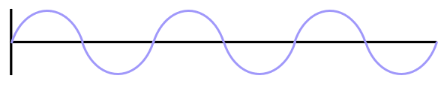
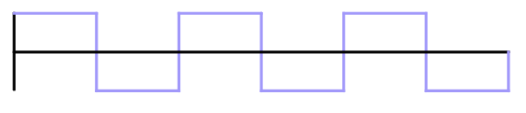
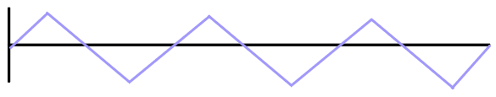
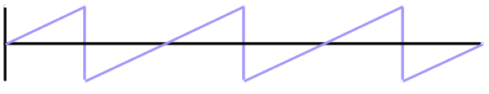
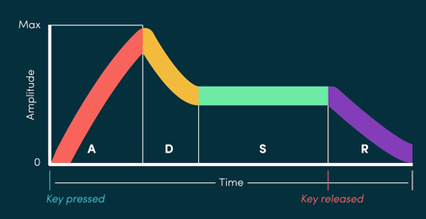
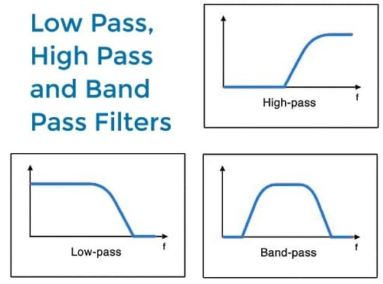
Content Area 2: The Digital Audio Workstation (DAW)
14. A mono audio channel has one/two channels of audio. (Delete wrong answer)
15. A stereo audio channel has one/two channels of audio. (Delete wrong answer)
16. Synthesisers. It is likely you will be asked about these.
Oscillators generate waveforms. Name the waveforms.
………………
………………
………………
Synth users can shape the sound using the ADSR (envelope).
i) What does each letter stand for?
ii) What does it describe?
………………
Envelope
A: ………………
Description: …………….................................
D: ………………
Description: ……………..................................
S: ………………
Description: ……………..................................
R: ………………
Description: ……………..................................
Filters further shape the sound.
- On the left, identify the filters.
- Which frequencies are removed by each type of filter?
Low-pass:
…………………………………………..
B) Band-pass:
……………………………………………
C) Low-pass:
……………………………………………
i) ………………..
ii) ………………..
iii) ……………..
18

Slide 23
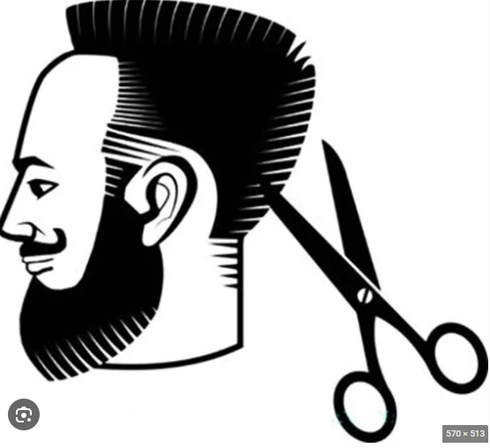
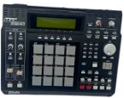

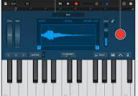


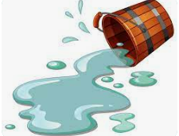

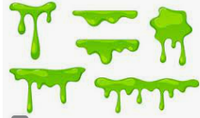
Content Area 2: The Digital Audio Workstation (DAW)
17. Samplers. It is likely you will be asked about these.
Complete the missing words to describe the use of samplers.
You can apply …..… and …….. to tidy up your samples.
And you can also …….. the sample to the pitch you want.
You can program samples to …………
There are hardware and ……….. samplers.
You can get a natural sound if you …………….. the sample yourself.
However, it is more …….. …………… to do this because you must set up equipment and record a good take.
Samples are often used instead of real drums, because of the lack of ………………., the ability to …………. samples and the ………………….. of repeating them.
19

Slide 24
Content Area 3: Musical Elements, Musical Styles & Music Technology
Key exam questions:
Listen to a track and analyse the use of the elements of music
Explain how specific tech influenced genres, e.g. the bass guitar & rock and roll.
Specific music theory questions e.g. identifying chords.
This is almost guaranteed, big-mark stuff!
20

Slide 25
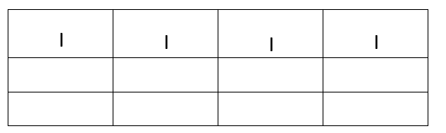
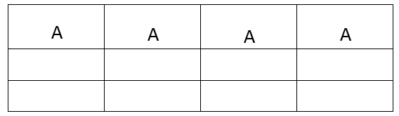
Content Area 3: Musical Elements, Musical Styles & Music Technology
Structure & Form
1. Form. Name the different musical forms. The first is done for you.
Binary
C
A
A
B
A
B
C
D
E
C
B
A
A
B
B
A
A
A
B
A
A
A
A
A
2. Complete the roman numerals for the 12-bar blues. The first line is done for you.
3. Complete the12-bar blues chords for the key of A. The first line is done.
4. Structure. Name the different structural sections. The first is done for you.
Chorus
New chord sequence. Lyrics repeat every time. Often loud dynamics, full instrumentation. Might contain the name of the song.
Chords repeat, lyrics change. Tells the story of the song
Build-up section before a chorus.
A repeated lyric
A sound that rises in pitch or volume
Brings the song to an end. Different to an outro.
Might feature verse/chorus chord progression, stripped back instrumentation
The end of a build-up section.
Either a pre-chorus or middle 8.
Section where parts are stripped back. Often solos.
21

Slide 26
Content Area 3: Musical Elements, Musical Styles & Music Technology
Melody
1. Scales. Practise forming the different scales in different keys. The formulae are in your knowledge organiser. A few boxes are provided below but you can practise anywhere. I recommend practising each scale at least a few times.
Name of scale: ……………………
Major
Name of scale: ……………………
Name of scale: ……………………
Name of scale: ……………………
Natural Minor
Name of scale: ……………………
Name of scale: ……………………
Name of scale: ……………………
Harmonic Minor
Name of scale: ……………………
22

Slide 27
Content Area 3: Musical Elements, Musical Styles & Music Technology
Melody
Name of scale: ……………………
Major pentatonic
Name of scale: ……………………
Name of scale: ……………………
Name of scale: ……………………
Minor Pentatonic
Name of scale: ……………………
Name of scale: ……………………
Name of scale: ……………………
Open practice
Name of scale: ……………………
23

Slide 28
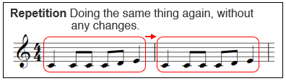
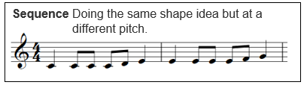
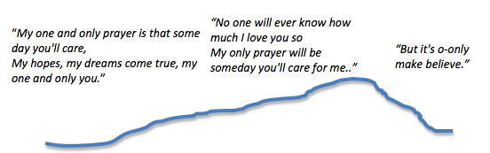
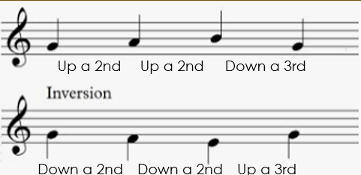


Content Area 3: Musical Elements, Musical Styles & Music Technology
Melody
2. Melodic forms. Name the melodic forms.
A)
B)
C)
Arch form: the notes of the melody form an arch.
3. Melodic devices. Name the melodic devices.
A)
Travelling up/down the scale by the same interval but in the opposite direction (upside down).
B)
Reversing the order of the notes so they appear backwards.
4. Define chromatic and diatonic:
………………………………………………………………………………………………………………
………………………………………………………………………………………………………………
24

Slide 29


Content Area 3: Musical Elements, Musical Styles & Music Technology
Harmony
Identifying chords: It is likely you will be asked to identify chords.
Work out the individual notes. (Notes in the space spell FACE. Lines = EGBF)
If you have no clue, take a guess based on the bottom note. E.g. CEG = C
Use these formulae below:
Major = root + 4 + 3 Minor = root + 3 + 4
Identify the major and minor chords.
i)……........
ii)……........
iii)…….......
iv)…….......
v)…….......
vi)…….......
vii)…….......
viii)……......
Identifying augmented chords:
Augmented chords are major chords, but the last note is raised a semitone.
E.g. CEG becomes CEG# (C major -> C augmented)
i)……........
ii)……........
iii)…….......
iv)…….......
Identifying diminished chords:
Diminished chords are minor chords, but the last note is lowered a semitone.
E.g. C, Eb, G becomes C, Eb, Gb (C minor -> C diminished).
i)……........
ii)……........
iii)…….......
iv)…….......
Identifying 7th chords:
Major 7th = major chord + another note e.g. CEG + B = C major 7
Minor 7th = minor chord + another note e.g. EGB + D = E minor 7.
i)……........
ii)……........
iii)…….......
iv)…….......
25

Slide 30


Content Area 3: Musical Elements, Musical Styles & Music Technology
Harmony
Suspended chords: Suspended chords are major chords where the middle note is replaced with the 2nd or 4th note of the scale. 2nd = sus2, 4th = sus4.
E.g. CEG -> CDG = Csus2. CEG-> CFG = Csus4
i)……........
ii)……........
iii)…….......
iv)…….......
2. Writing chords: Use the space below to write the following chords:
Major & minor = F major/G major/E major/F minor/G minor/E minor
7th chords = F maj 7th/ G maj 7th/E maj 7th/F min 7th/G min 7th/E min 7th
Augmented & Diminished chords: F aug/G aug/E aug/F dim/G dim/E dim
Suspended chords: Fsus2/Gsus2/Esus2/Fsus4/Gsus4/Esus4
26

Slide 31
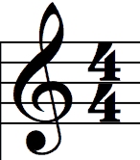
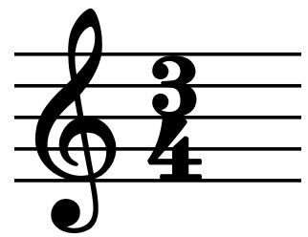
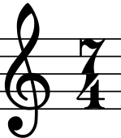
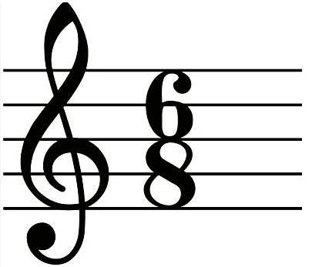
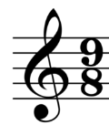
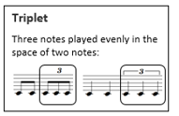

Content Area 3: Musical Elements, Musical Styles & Music Technology
Rhythm
1. What do the two numbers of a time signature tell you?
Top number: …………………
B) Bottom number: ……………….….
2. A 4 on the bottom = crotchet beats. An 8 on the bottom = quaver beats. Therefore, explain what is meant by the following time signatures:
Beats per bar: ……………
Type of beat: ………………
Beats per bar: ……………
Type of beat: ………………
Beats per bar: ……………
Type of beat: ………………
Beats per bar: ……………
Type of beat: ………………
2. Common time signatures mean each beat can be divided into ……………….
3. Compound time signatures mean each beat can be divided into ……………….
4. Triplets are when …..…. notes are played in the same amount of time as you
would normally play ……..
5. Dotted notes are worth 1.5x the original note value.
How many beats is each of these worth?
A) ……….
B) ……….
C) ……….
27

Slide 32
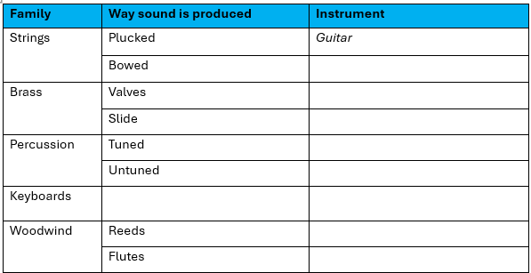
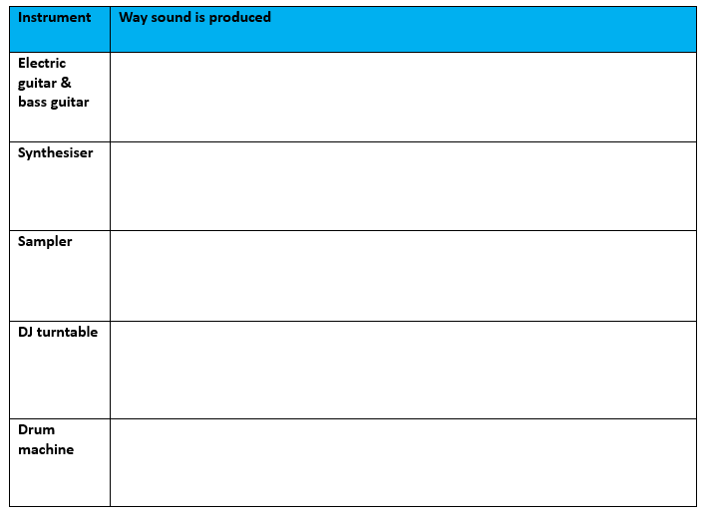
Content Area 3: Musical Elements, Musical Styles & Music Technology
Instrumentation
1. Acoustic Instruments. For each type, name an instrument. The first is done for you.
2. Electric Instruments. For each instrument, describe how sound is produced..
28

Slide 33
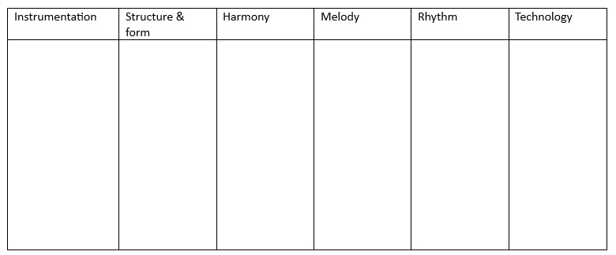
Content Area 3: Musical Elements, Musical Styles & Music Technology
Musical Styles
You will be asked about musical styles.
The best way to revise is to practise recalling how the different styles use the elements of music. Try to do this without looking at the knowledge organiser, or do a look/cover/write/check.
Rock and roll
Decade:
Rock
Decade:
29

Slide 34
Folk
Decade:
Soul
Decade:
Funk
Decade:
30

Slide 35
Decade:
Disco
Reggae
Decade:
Hip hop
Decade:
31

Slide 36
Electronica
Decade:
Dance
Decade:
21st Century Pop
Decade:
32

Slide 37
Content Area 3: Musical Elements, Musical Styles & Music Technology
Task: complete the box for each piece of technology.
Technology
Electric guitar
Decade:
Feature 1:
Feature 2:
Benefit 1:
Benefit 2:
Bass guitar
Decade:
Feature 1:
Feature 2:
Benefit 1:
Benefit 2:
2-track recording
Decade:
Benefit 1:
Benefit 2:
4 & 8-track recording
Decade:
Benefit 1:
Benefit 2:
Hardware effects
Decade:
Examples:
Benefit 1:
Benefit 2:
Analog synthesis
Decade:
Feature 1:
Feature 2:
Benefit:
Drum machine
Decade:
Feature 1:
Feature 2:
Benefit:
Disadvantage:
Analog sampler:
Decade:
Benefits:
Disadvantage:
16 & 24-track recording
Decade:
Benefit 1:
Benefit 2:
Digital sampler
Decade:
Features:
Benefits:
Digital tape recording
Decade:
Benefit 1:
Benefit 2:
Digital synthesis
Decade:
Features:
Benefits:
MIDI
Decade:
Stands for:
Benefits:
Disadvantage:
Portastudio
Decade:
Features:
Benefit 1:
Benefit 2:
Hard disk-based recording
Decade:
Benefits:
Keyboard workstation
Decade:
Features:
Benefits:
DAW
Decade:
Features:
Benefits:
Audio Processing Plug-ins
Decade:
Examples:
Benefits:
Analogue Hardware revival
Decade: Examples:
Advantages:
33

Slide 38
Content Area 4: Sound Creation
Key exam questions:
How sound is created for specific forms of media and…
Evaluating different ways to create sound e.g sound library vs foley creation.
34

Slide 39
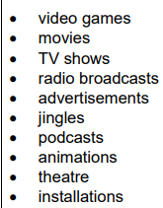
Content Area 4: Sound Creation
Forms of Media
You will have a question about sound creation, so it is important to understand how sound is used for each type of media.
Use the space below (and on the next page) to create mind-maps on how sound is used in the different types of media.
35

Slide 40
Content Area 4: Sound Creation
Forms of Media
36

Slide 41
Content Area 4: Sound Creation
Types of Sound Creation
1. Match the description to the type of sound creation.
Foley
Atmospheric sounds e.g. rain
Ambience
The reproduction of everyday sounds using props
Dialogue
Voice-overs
Narration over what is happening on-screen
Underscore
Specific hard-to-recreate sound events e.g explosions
Spot effects
Characters speaking to one another
Revision tip: think about how sound is produced in each of these types. What are benefits/disadvantages of different methods?
The music underpinning the action
2. Evaluate the advantages and disadvantages of both using commercial libraries for foley and creating your own.
…………………………………………………………………………………………………………
…………………………………………………………………………………………………………
…………………………………………………………………………………………………………
…………………………………………………………………………………………………………
………………………………………………………………………………………………………….
………………………………………………………………………………………………………….
…………………………………………………………………………………………………………..
……………………………………………………………………………………………
……………………………………………………………………………………………
……………………………………………………………………………………..........
……………………………………………………………………………………..
37

Slide 42
Content Area 4: Sound Creation
Types of Sound Creation
1. Use the keywords below to answer the following questions about sound arrangement..
Layering
Texture
Mood
Style
Impact
Non-diegetic
Diegetic
A) Composers may consider the ……..… , e.g. a film set in 1930s Chicago may feature jazz music.
Different layers of sound build up a thick …………………
Composers should consider the …………………. of a scene when composing.
Composers should consider how they want to …………………… the audience.
Using more than one recording to build up a realistic sound is called ……………………… .
Two characters listening to the radio in a film scene is an example of ………………… sound.
An underscore is an example of ………………… sound.
Exporting Sound Creation
Use this space to mind-map different file types used in exporting sound creation, especially video formats.
Revision tip: have a think how synthesisers and samplers may be used in different sound creation contexts. It is possible you will be asked.
38

Slide 43
Content Area 5: Multitrack Recording
Key exam questions:
Name and explain recording equipment
Name and explain mixing techniques
ANALYSE A MIX < - this will likely be your 12-mark question.
This is almost guaranteed, big-mark stuff!
39

Slide 44
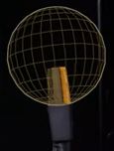
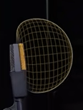
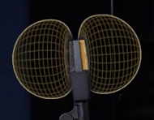
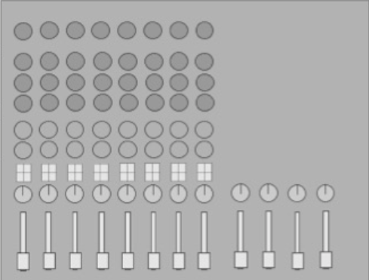
Content Area 5: Multitrack Recording
Equipment
1.Identify the polar patterns.
A)
B)
C)
2. What might you record with each of these polar patterns?
A)
B)
C)
3. Phantom power is required by condenser/dynamic mics (underline correct answer).
4. Balanced/unbalanced audio reduces noise (underline correct answer).
5. Label the different parts of the mixing desk.
Channel fader
EQ
Pan
Gain
Aux sends
Master fader
6. Define overdubbing: ………………………………………………………………………………………………..
7. Give two benefits of overdubbing: ………………………………………………………………………………
…………………………………………………………………………………………………………………………………
Which control on the mixing desk would you use if the signal was too quiet or distorting?
..................................................
9. A pop shield boosts volume/reduces plosive sounds/widens panning (underline correct).
10. You are going to record vocals. Name three pieces of equipment for the control room and three for the live room.
…………………………………………………………………………………………………………………………………
………………………………………………………………………………………………………………………
40

Slide 45
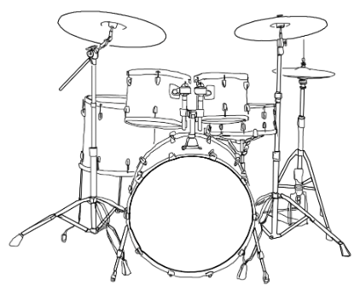
Content Area 5: Multitrack Recording
Planning recording sessions
Name three job roles that work in the studio.
……………………………………………………………………………………………………………….
2. Recording sessions usually are booked for a set number of hours. Identify why this might cause problems.
……………………………………………………………………………………………………………
3. To work out how long you need to record a song, what questions might you ask the artist?
i ) …………………………………………………………………………...
ii) …………………………………………………………………………..
iii) …………………………………………………………………………..
4. Draw how you would mic up this drum kit. Label all the equipment; include whether you would use dynamic or condenser mics; and which polar patterns you are using.
41

Slide 46

Content Area 5: Multitrack Recording
Planning recording sessions
5. Draw how you would mic up vocals. Label all the equipment; include whether you would use dynamic or condenser mics; and which polar patterns you are using.
Condenser or dynamic mic?
Pop shield?
Shock mount?
Mic stand
Reflection filter?
What are the distances?
Mixing
6. Choose three instruments, explain where you would pan them and why.
Instrument | Panning | Reason
7. Which one of these is NOT a way to remove unwanted audio? Underline.
Noise gate Compression Automation
8. Which plug-in can you use if you have pitch errors? ……………………………………
9. A drum recording has a few hits out of time. Which of these is a solution?
Use EQ Use pitch correction Cut out the hits and place them in time
10. What does EQ stand for? ……………………………………………
11. In EQ, what does Q control? ……………………………………………………………………
42

Slide 47
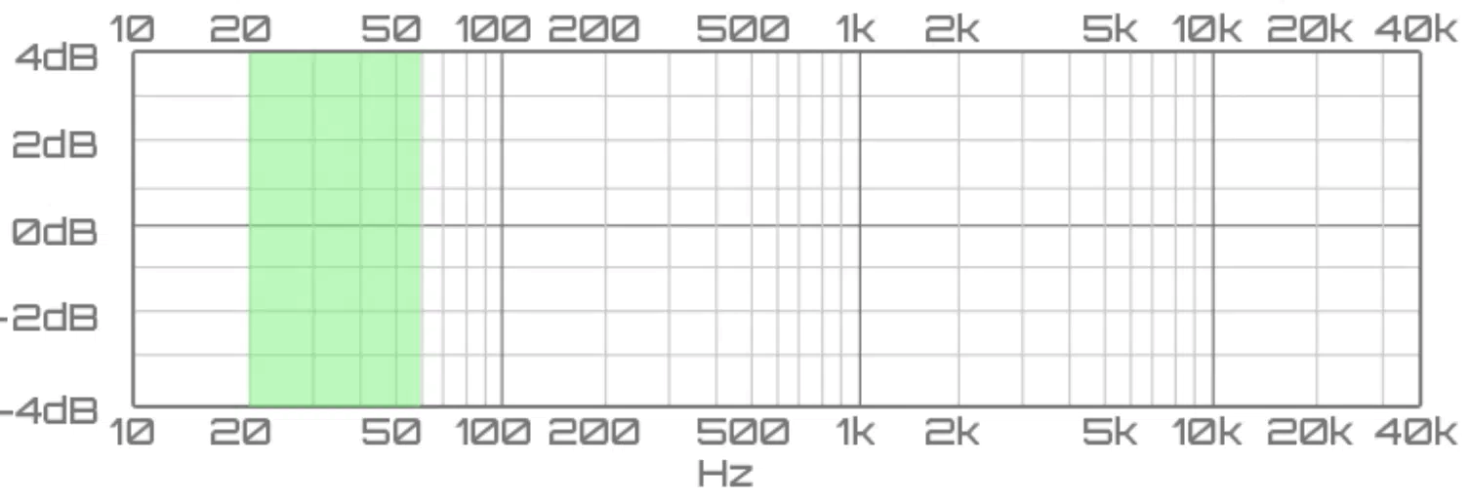
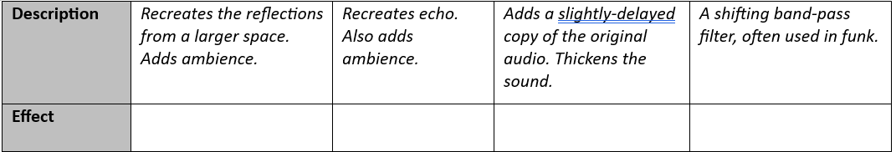
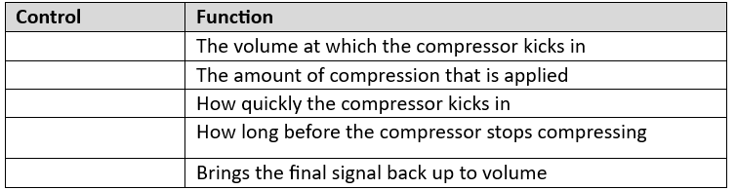
Content Area 5: Multitrack Recording
Mixing
12. On the EQ graphs, draw high-pass, low pass & band pass filters.
High-pass filter
Low-pass filter
Band-pass filter
13. Name the effect being described.
14. Why might you use an amp simulation plug-in?
………………………………………………………………………………………………………………
15. Identify the different controls of a compressor.
Release
Threshold
Ratio
Gain
Attack
43

Slide 48
Content Area 5: Multitrack Recording
Mixing
16. Why use noise gate? ………………………………………………………………………………
17. What does a limiter do? ………………………………………………………………………….
18. Which function would you use to gradually increase reverb length over time?
Automation Reverse Copy & paste
19. When you are mixing, why is it important to listen to mixes on a range of speakers and headphones?
………………………………………………………………………………………………………………..
………………………………………………………………………………………………………………..
………………………………………………………………………………………………………………..
20. Why is it useful to listen to reference mixes when mixing? …………………………
……………………………………………………………………………………………………………...
…………………………………………………………………………………………………………......
21. What are the minimum sample rate and bit depth for quality audio?
Sample rate: ……………………………………………….
Bit depth …………………………………………………
22. Name an:
Uncompressed audio file type:…………………………………………..
Compressed audio file type: ……………………………………………………….
44

