Slide 1
NCFE Level 1/2 Technical Award in Music Technology
Exam Revision Guide
ANSWERS

Slide 2
Part Two: Revision Activities
Working through these revision activities will ensure that you have at least revisited most of the content within the course.
Content Area 1: The Music Business and Music Technology
Key exam questions:
How key pieces of tech have developed
Marketing, promotion, distribution and PRS/MU
8

Slide 3
Content Area 1: the Music Business & Music Technology
1. It is likely you will be asked to identify job roles & describe what they do.
Write the different job roles, based on the responsibilities. (Also use FLASHCARDS)
Role | Responsibilities
Composer | Work to a brief; rehearse material; compose music
Lyricist | Work alongside composer; work to a brief; compose lyrics
Technician | Repair instruments; tune instruments
Producer | Control of studio session; creative input; coach artists
Songwriter | Similar to a composer except also write lyrics
Session musician | Tune and maintain instrument; learn music quickly to perform on recordings
Arranger | Take composed music and decide which instruments play what, and how.
Sound designer | Create/record sounds for film, TV, games etc.
DJ | Create playlists of recordings to perform in a venue /radio
Artist manager | Negotiate contracts; find opportunities for clients
Engineer | Set up microphones & DAW projects; manage playback
Publicist | Create marketing strategies; run promo campaigns; develop public image
A&R | Scout artists for labels; develop artists’ sound
2. You need to know the benefits of 2/4/8/16/24 track magnetic recording tape. Write them below
2-track tape
Decade popular: 1950s
Benefits:
Record vocals & band separately
Stereo is possible
4 & 8-track tape
Decade popular: 1960s
Benefits:
More mics per instrument = better quality
Record more instruments at the same time = layering
Reduction mixing possible
16 & 24-track tape
Decade popular: 1970s
Benefits:
Multiple mics per instrument
Record many instruments
Fewer artefacts
9

Slide 4
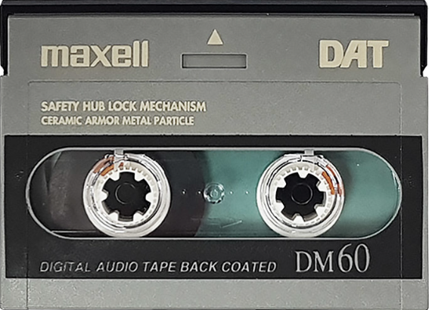

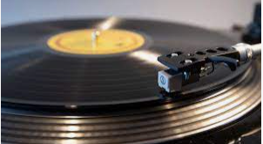

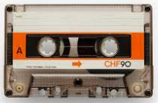


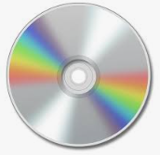


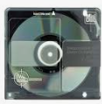
Content Area 1: the Music Business & Music Technology
3. This question is about DASH tape. Fill in the blanks.
Digital tape converts the incoming audio signal into a data stream of
binary information (1s and 0s).
This is recorded onto the tape via the record head.
DASH can record 2 channels of audio to ¼” inch tape or 24/48 channels to ½ inch tape.
Advantages: a) consistent, flat frequency response b) high dynamic range
4. This question is about Alesis Digital Audio Tape. Fill in the blanks,
Magnetic 8-track tape. Uses the same S-VHS tape as a VCR.
You can sync multiple ADATs together (up to 16), giving a total 128 possible tracks.
The ADAT HD24 replaced the original ADAT. This records 24 tracks to hard disk.
ADAT technology is still used in studios to sync different audio interfaces.
5. Consumer audio formats.
Label each consumer audio format.
Provide advantages and disadvantages
Cassette
Adv: Portable, stores more than vinyl.
Disadv: Easy to damage/warp
Vinyl
Adv: Perceived warm sound
Disadv: can warp, can scratch, limited storage, is big so takes up a lot of space
YouTube
Adv: Can access anywhere with internet connection. Large library that is free.
Disadv: Have to pay to remove ads. No physical connection to the product. Relies on internet.
Compact Disc (CD)
Adv: Can store more audio than cassette/vinyl. Higher quality audio than streaming.
Disadv: Can scratch easily.
Streaming services
Adv: Can access anywhere with internet connection. Massive free library. Cheap even with subscription.
Disadv: Uses lossy compression. Requires internet connection.
MP3 player
Adv: Portable, can store much more than other physical media.
Disadv: MP3 is lossy compression – worse quality
Minidisc
Adv: Higher quality than CD. Easier to store because smaller.
Disadv: Limited availability. Everyone had already bought CDs.
10

Slide 5
Content Area 1: the Music Business & Music Technology
6. Marketing. Create a mind-map for marketing:
What is it?
What is involved?
Why is it important?
Activities a company undertakes to promote the buying of its products
Logos
Colour schemes
Development of the brand
Marketing
Market research
Audience demographic
Campaign: visibility of artists
Social media
7. Promotion. (Extended written answer practice) Describe and evaluate the differences between physical and digital promotion methods. To do this, list different ways of promoting music. Then discuss the advantages and disadvantages.
Physical promotion: One way of promoting physically is flyers. This involves handing out leaflets that advertise your music or perhaps a concert or tour. An advantage of this is that you can direct your flyers towards your target demographic, e.g. by handing them out outside a gig by a musician similar to your own style of music. Disadvantages are that they are time consuming to produce (and cost money) and time consuming to distribute.
Another approach to physical promotion is tours. An advantage of tours is that you can sell merchandise while promoting your music on stage, enabling you to earn while promoting. Additionally, concert-goers can develop a stronger bond with the artist by seeing them in person, rather than engaging online. A disadvantage of concerts as a promotional device is that they are very costly to carry out, and a majority of attendees will often already be fans, meaning you might not be broadening your fanbase considerably.
Digital promotion: One way of promoting music digitally is through social media posts. Advantages of social media posts are that they are free to produce and can reach a large audience instantly, making them a much faster delivery method than physical promotion. A disadvantage is that the target audience will see your post as one of many, meaning that you are less likely to have meaningful impact on them than if they attended a concert, for example.
Another way to promote music digitally is live streaming. Artists sometimes stream whole concerts, or small intimate performances. Advantages of this is that your audience can access your live music without paying for a concert ticket, and the musician does not have to pay for an expensive tour. A disadvantage is that physical merchandise is not as readily available as it would be at an in-person content.
11

Slide 6



Content Area 1: the Music Business & Music Technology
8. Merchandise. Create a mind-map for merchandise:
Give examples of merch
Where might it be sold?
What makes it effective?
Visual products: posters, signed photographs, autographs
Clothing: hoodies, t-shirts, hats
Sold at concerts, on websites, via social media
Accessories: phone cases, guitar picks, keyrings
Merchandise
Effective: branding – logos, fonts, colour schemes
Availability
9. Physical distribution. Annotate the diagram to explain the process of getting physical copies of music to the shops..
Manufacturer
Distribution company
Retail
The record label sends the master audio files to a manufacturer. The manufacturer produces physical copies in a factory.
The distribution company collects the physical copies from the factory and takes them to shops to be sold.
Shops sell the product at a ‘mark-up’ to get their profit. They may do promotions such as in-store performances to promote the product.
10. Digital distribution. Use the space below to explain how digital distribution services work.
Record labels, or independent artists, pay an aggregator, such as ReverbNation, to upload their music to streaming and digital music sites. Users either stream (Spotify) or purchase (Apple Music) music, which generate royalties. The aggregator collects the royalties and distributes them to the artist.
Aggregators either charge a one-off fee for this service or they take a percentage of the royalty as their service charge.
12

Slide 7
Content Area 1: the Music Business & Music Technology
11. PRS for Music. Circle or highlight the five true statements about PRS for Music
When a recording is played in public, a royalty is generated
PRS is a rapper from Chicago
PRS is a royalty collection and distribution service
PRS collect monies from artists
PRS collect monies from license-holders
Businesses that play music in public spaces do not need a license.
Businesses that play music in a public space must have a PRS license.
PRS distribute royalties to their rights-holders (artists)
PRS distribute royalties to their license-holders.
12. The Musician’s Union. In your own words, describe what the Musician’s Union does and what the benefits are of joining MU. You can write in full sentences, bullet points or complete a mind-map.
Instrument insurance: by paying regularly to the MU, the union will replace lost, stolen or damaged musical equipment.
Contract/legal advice: the MU will give you advice on your contracts or any legal difficulties you may have.
Pay disputes: the MU will help you recover your fee if you are not paid for work.
Lobby the government: the MU will fight for rights and benefits for the music industry on your behalf.
Professional development: they will support you with information and courses to develop you as a professional.
13

Slide 8
Content Area 2: The Digital Audio Workstation (DAW)
Key exam questions:
Identify specific pieces of kit, e.g. XLR cables & explain their uses
Synths and samplers
14

Slide 9
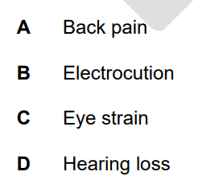

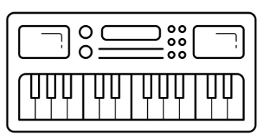

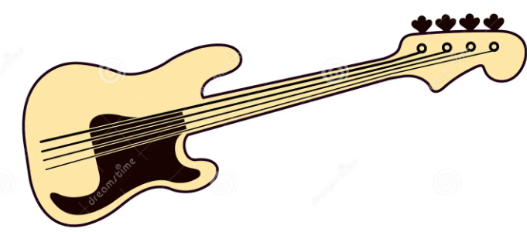
Content Area 2: The Digital Audio Workstation (DAW)
1. Health & safety will probably come up at some point. Below are some potential injuries. What could cause them and how could you prevent them?
Cause: sitting for too long. Prevent: take rest breaks
Cause: faulty electrics. Prevent: have equipment PAT tested.
Cause: looking at screens for too long. Prevent: Take rest breaks
Cause: listening (esp. on headphones) too loud for too long. Prevent: Limit volume/take rest breaks/use open-back headphones
2. It is likely you will be asked about connections (cables). In the space below, label how the MIDI keyboard, audio interface and bass guitar can be connected.(e.g. XLR cable).
USB
USB
¼” jack cable
3. At some point, they will probably ask you about different audio file types. In the space below, create a mind-map of uncompressed and compressed audio formats. Include examples, advantages and disadvantages.
Example: WAV
Advantages: higher quality/no data loss
Disadvantages: takes up more storage/can be difficult to transfer
Example: mp3
Advantages: takes up less storage
Disadvantage: lesser quality/data loss
Uncompressed audio
Compressed audio
15

Slide 10
Content Area 2: The Digital Audio Workstation (DAW)
4. Annotate the mind-map to explain the purpose of the computer hardware.
Store data online
The amount of data that can be loaded at once
Network Drive
Cloud Storage
Storage for users in an organization e.g. school
RAM
Operating system
Hard drive
Storage device. Has moving parts.
The way the user interacts with the software.
Solid state drive (SSD)
Display
Storage device. No moving parts.
What you look at.
Universal Serial Bus (USB)
Method of data transfer.
5. Use the keywords below to explain the function of MIDI controllers. Describe the features and provide advantages/disadvantages of using MIDI controllers over real instruments.
MIDI controllers
Guitar/keyboard/percussion/wind
Pitch
Velocity
Duration
USB
5-pin DIN cable
Pitch bend
Modulation wheel
Humanisation
There are different types of MIDI controllers: guitar, keyboard, percussion and wind.
MIDI controllers output pitch, velocity and duration information.
Modern MIDI controllers output data via USB. Older devices use a 5-pin DIN cable.
MIDI controllers can also send pitch bend information by using the modulation wheel.
MIDI data can be made to sound more natural by humanisation processes such as velocity editing.
16

Slide 11
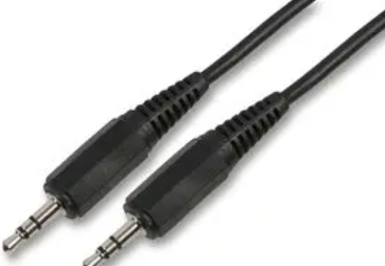
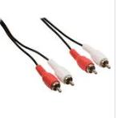
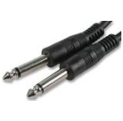
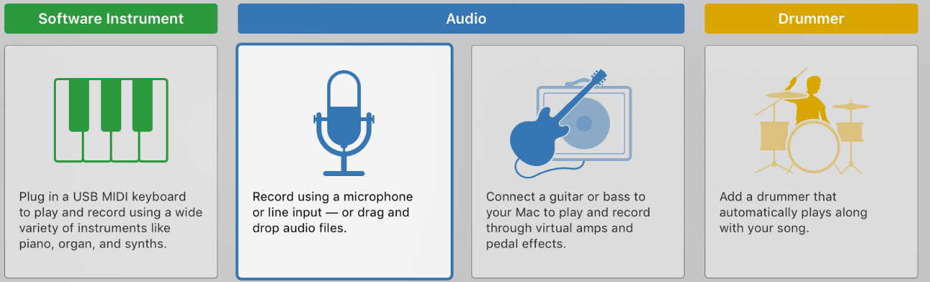
Content Area 2: The Digital Audio Workstation (DAW)
6. Connect the line input cable to the uses and the correct image.
RCA phono cable
Guitars and other instruments
¼” jack cable
Turntables/CD players
Mini jack cable
Headphones, mp3 player, phone
7. Match the features to cloud-based and desktop-based DAWs.
Desktop-based DAWS
Cloud-based DAWS
Can be accessed anywhere with the internet
Can be accessed without the internet
Will run more smoothly
Less likely to be hacked
Easier to share projects/collaborate
Less likely to lose work
8. The minimum bit depth for quality recordings is 16.
9. The minimum sample rate for quality recordings is 44.1kHz. .
10. When recording, the buffer size should be small (delete wrong answer).
11. When mixing, the buffer size should be large (delete wrong answer).
12. What can happen if the wrong buffer size is used? Latency
13. Circle the correct track type for note input.
17

Slide 12
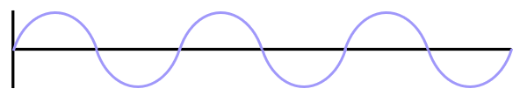
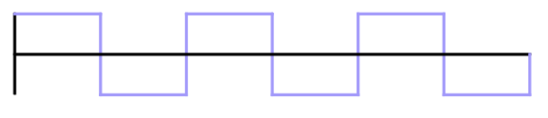
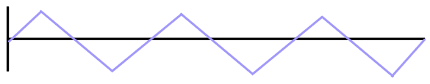
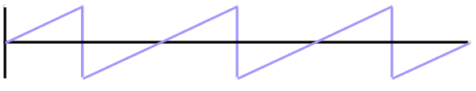
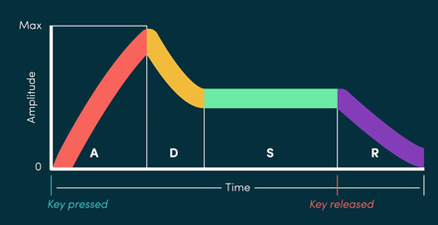
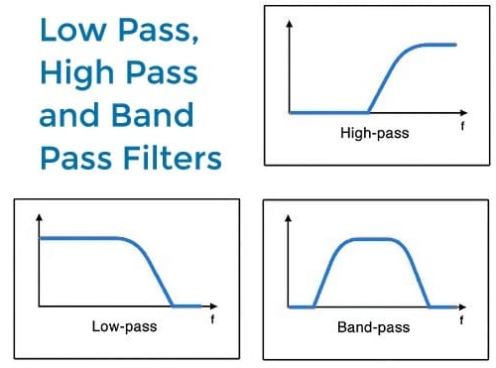
Content Area 2: The Digital Audio Workstation (DAW)
14. A mono audio channel has one channel of audio. (Delete wrong answer)
15. A stereo audio channel has two channels of audio. (Delete wrong answer)
16. Synthesisers. It is likely you will be asked about these.
Oscillators generate waveforms. Name the waveforms.
Sine
Square
Triangle
Synth users can shape the sound using the ADSR (envelope).
i) What does each letter stand for?
ii) What does it describe?
Sawtooth
Envelope
A: Attack
Description: The time to reach full volume.
D: Decay
Description: The time for the initial peak to resolve
S: Sustain
Description: The note being held
R: Release
Description: The time to go silent after letting go.
Filters further shape the sound.
- On the left, identify the filters.
- Which frequencies are removed by each type of filter?
HIGH (typo!)-pass:
Low
B) Band-pass:
High and low
C) Low-pass:
High
i) High pass
ii) Low-pass.
iii) Band-pass
18

Slide 13
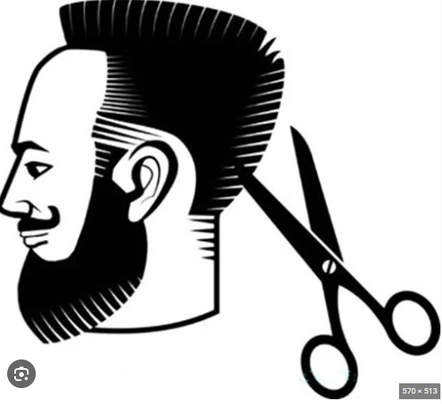
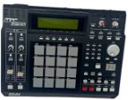

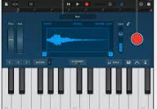


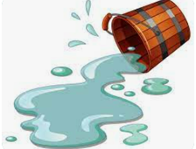
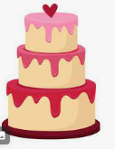
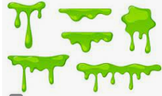
Content Area 2: The Digital Audio Workstation (DAW)
17. Samplers. It is likely you will be asked about these.
Complete the missing words to describe the use of samplers.
You can apply trims and fades to tidy up your samples.
And you can also map the sample to the pitch you want.
You can program samples to loop
There are hardware and software. samplers.
You can get a natural sound if you record the sample yourself.
However, it is more time consuming to do this because you must set up equipment and record a good take.
Samples are often used instead of real drums, because of the lack of spill, the ability to layer samples and the consistency of repeating them.
19

Slide 14
Content Area 3: Musical Elements, Musical Styles & Music Technology
Key exam questions:
Listen to a track and analyse the use of the elements of music
Explain how specific tech influenced genres, e.g. the bass guitar & rock and roll.
Specific music theory questions e.g. identifying chords.
This is almost guaranteed, big-mark stuff!
20

Slide 15
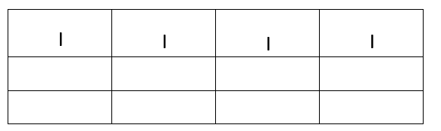
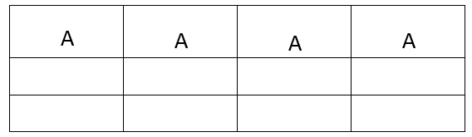
Content Area 3: Musical Elements, Musical Styles & Music Technology
Structure & Form
1. Form. Name the different musical forms. The first is done for you.
Binary
Through-composed
Arch
C
A
A
B
A
B
C
D
E
C
B
A
A
B
B
A
Rondo
Ternary
Strophic
A
A
B
A
A
A
A
A
2. Complete the roman numerals for the 12-bar blues. The first line is done for you.
3. Complete the12-bar blues chords for the key of A. The first line is done.
I | I | I | I
IV | IV | I | I
V | IV | I | I/V7
A | A | A | A
D | D | A | A
E | D | A | A/E7
4. Structure. Name the different structural sections. The first is done for you.
Chorus
Verse
New chord sequence. Lyrics repeat every time. Often loud dynamics, full instrumentation. Might contain the name of the song.
Chords repeat, lyrics change. Tells the story of the song
Pre-chorus
Refrain
Riser
Build-up section before a chorus.
A repeated lyric
A sound that rises in pitch or volume
Coda
Intro
Brings the song to an end. Different to an outro.
Might feature verse/chorus chord progression, stripped back instrumentation
Drop
Bridge
The end of a build-up section.
Breakdown
Either a pre-chorus or middle 8.
Section where parts are stripped back. Often solos.
21

Slide 16
Content Area 3: Musical Elements, Musical Styles & Music Technology
Melody
Name of scale:
Major
Name of scale: ……………………
Name of scale: ……………………
Google it or ask Mr Ruston
Name of scale: ……………………
Natural Minor
Name of scale: ……………………
Name of scale: ……………………
Name of scale: ……………………
Harmonic Minor
Name of scale: ……………………
22

Slide 17
Content Area 3: Musical Elements, Musical Styles & Music Technology
Melody
Name of scale: ……………………
Major pentatonic
Name of scale: ……………………
Name of scale: ……………………
Google it or ask Mr Ruston
Name of scale: ……………………
Minor Pentatonic
Name of scale: ……………………
Name of scale: ……………………
Name of scale: ……………………
Open practice
Name of scale: ……………………
23

Slide 18
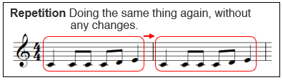
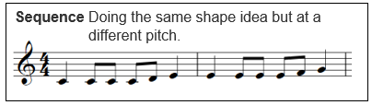
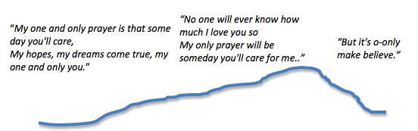
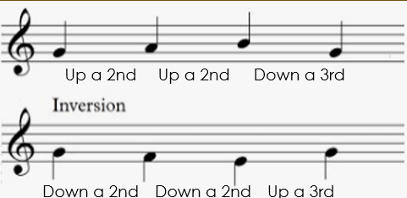


Content Area 3: Musical Elements, Musical Styles & Music Technology
Melody
2. Melodic forms. Name the melodic forms.
Arch form: the notes of the melody form an arch.
3. Melodic devices. Name the melodic devices.
A) Inversion
Travelling up/down the scale by the same interval but in the opposite direction (upside down).
B) Retrograde
Reversing the order of the notes so they appear backwards.
4. Define chromatic and diatonic:
Chromatic means using notes from outside of the scale. Diatonic means using only notes from within the scale.
24

Slide 19


Content Area 3: Musical Elements, Musical Styles & Music Technology
Harmony
Identifying chords: It is likely you will be asked to identify chords.
Work out the individual notes. (Notes in the space spell FACE. Lines = EGBF)
If you have no clue, take a guess based on the bottom note. E.g. CEG = C
Use these formulae below:
Major = root + 4 + 3 Minor = root + 3 + 4
Identify the major and minor chords.
i) F major
ii) E minor
iii) C major
iv) A minor
v) G major
vi) D minor
vii) E major
viii) D major
Identifying augmented chords:
Augmented chords are major chords, but the last note is raised a semitone.
E.g. CEG becomes CEG# (C major -> C augmented)
i) F augmented
ii) E augmented
iii) G augmented
iv) C augmented
Identifying diminished chords:
Diminished chords are minor chords, but the last note is lowered a semitone.
E.g. C, Eb, G becomes C, Eb, Gb (C minor -> C diminished).
i) E diminished
ii) C diminished
iii) A diminished
iv) D diminished
Identifying 7th chords:
Major 7th = major chord + another note e.g. CEG + B = C major 7
Minor 7th = minor chord + another note e.g. EGB + D = E minor 7.
i) E minor 7th
ii) D minor 7th
iii) C major 7th
iv) G major 7th
25

Slide 20

Content Area 3: Musical Elements, Musical Styles & Music Technology
Harmony
Suspended chords: Suspended chords are major chords where the middle note is replaced with the 2nd or 4th note of the scale. 2nd = sus2, 4th = sus4.
E.g. CEG -> CDG = Csus2. CEG-> CFG = Csus4
i) Fsus2
ii) Dsus2
iii) Gsus4
iv) Csus4
2. Writing chords: Use the space below to write the following chords:
Major & minor = F major/G major/E major/F minor/G minor/E minor
7th chords = F maj 7th/ G maj 7th/E maj 7th/F min 7th/G min 7th/E min 7th
Augmented & Diminished chords: F aug/G aug/E aug/F dim/G dim/E dim
Suspended chords: Fsus2/Gsus2/Esus2/Fsus4/Gsus4/Esus4
Major & minor
7th chords
Augmented & diminished chords
Suspended 2nd & suspended 4th chords
26

Slide 21
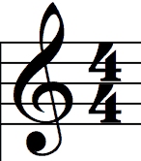
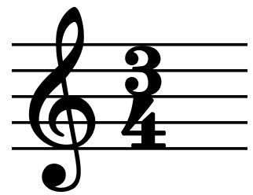
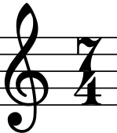
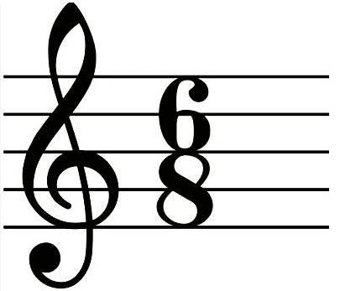
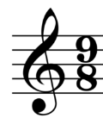
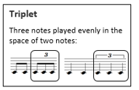

Content Area 3: Musical Elements, Musical Styles & Music Technology
Rhythm
1. What do the two numbers of a time signature tell you?
Top number: The number of beats
B) Bottom number: The type of beats
2. A 4 on the bottom = crotchet beats. An 8 on the bottom = quaver beats. Therefore, explain what is meant by the following time signatures:
Beats per bar: 3
Type of beat: crotchet
Beats per bar: 7
Type of beat: crotchet
Beats per bar: 6
Type of beat: quaver
Beats per bar: 9
Type of beat: quaver
2. Common time signatures mean each beat can be divided into 2
3. Compound time signatures mean each beat can be divided into 3
4. Triplets are when 3 notes are played in the same amount of time as you
would normally play 2.
5. Dotted notes are worth 1.5x the original note value.
How many beats is each of these worth?
A) 3
B) 1.5
C) ¾
27

Slide 22
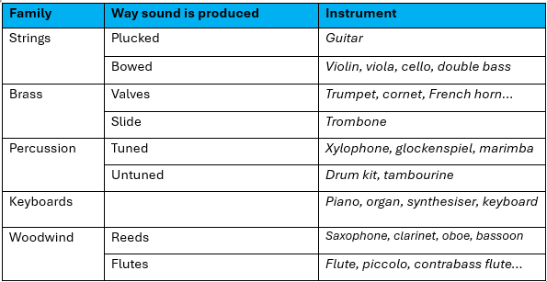
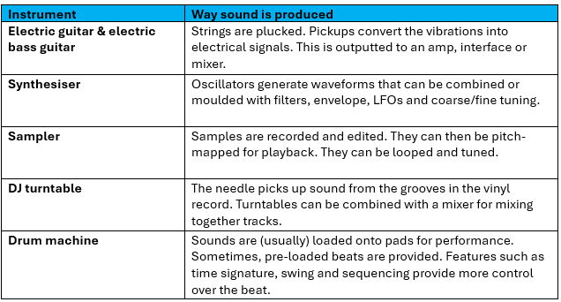
Content Area 3: Musical Elements, Musical Styles & Music Technology
Instrumentation
1. Acoustic Instruments. For each type, name an instrument. The first is done for you.
2. Electric Instruments. For each instrument, describe how sound is produced..
28

Slide 23
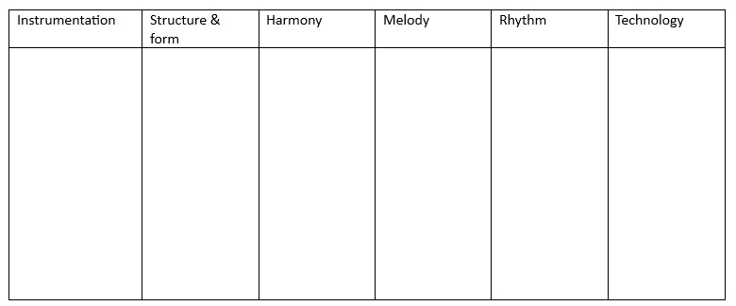
Content Area 3: Musical Elements, Musical Styles & Music Technology
Musical Styles
You will be asked about musical styles.
The best way to revise is to practise recalling how the different styles use the elements of music. Try to do this without looking at the knowledge organiser, or do a look/cover/write/check.
Rock and roll
Decade:
Use your knowledge organiser to mark this page.
Rock
Decade:
29

Slide 24
Folk
Decade:
Soul
Decade:
Use your knowledge organiser to mark this page.
Funk
Decade:
30

Slide 25
Decade:
Disco
Reggae
Decade:
Use your knowledge organiser to mark this page.
Hip hop
Decade:
31

Slide 26
Electronica
Decade:
Dance
Decade:
Use your knowledge organiser to mark this page.
21st Century Pop
Decade:
32

Slide 27
Content Area 3: Musical Elements, Musical Styles & Music Technology
Task: complete the box for each piece of technology.
Technology
Electric guitar
Decade: 1950s
Feature 1: Volume control
Feature 2: Tone control
Benefit 1: Can be heard over the ensemble.
Benefit 2: Create tones.
Bass guitar
Decade: 1950s
Feature 1: Volume control
Feature 2: Tone control
Benefit 1: More portable than double bass.
Benefit 2: Volume/tone control
2-track recording
Decade: 1950s
Benefit 1: Can separate the vocalist from the ensemble – clarity.
Benefit 2: Can create stereo recordings.
4 & 8-track recording
Decade: 1960s
Benefit 1: Reduction mixing
Benefit 2: Overdubbing
Benefit 3: Greater separation by miking instruments individually.
Hardware effects
Decade: 1960s
Examples: Wah-wah/distortion/reverb/tape delay
Benefit 1: Greater range of sounds to use.
Benefit 2: Leads to new genres
Analog synthesis
Decade: 1960s
Feature 1: Oscillators
Feature 2: Envelope/filters
Benefit: Wider range of sounds available/control over sound through features.
Drum machine
Decade: 1970s
Feature 1: Pre-made beats
Feature 2: Swing
Benefit: Complex, perfectly timed drums.
Disadvantage: Unrealistic.
Analog sampler:
Decade: 1970s
Benefits: Wider range of instruments available without having to play.
Disadvantage: Fewer features than digital.
16 & 24-track recording
Decade: 1970s
Benefit 1: More mics per instrument.
Benefit 2: More instruments per song.
Benefit 3: More overdubbing
Digital sampler
Decade: 1980s
Features: Pitch-mapping, tuning, looping, patches
Benefits: Wider range of features than analog/No need to play instruments.
Digital tape recording
Decade: 1980s
Benefit 1: Fewer artefacts.
Benefit 2: Quality less likely to degrade.
Digital synthesis
Decade: 1980s.
Features: Envelope, filter, LFO, oscillators, tuning.
Benefits: More features at lower cost than analog. More ability to sculpt the sound you want.
MIDI
Decade: 198s
Stands for: Musical Instrument Digital Interface
Benefits: Do not need to own or be able to play every instrument/can edit pitch and rhythm after performing/can apply humanisation.
Disadvantage: Unrealistic.
Portastudio
Decade: 1980s
Features: Multitrack recording, mixing features
Benefit 1: Recording becomes affordable at home.
Benefit 2: Portable.
Hard disk-based recording
Decade: 1990s
Benefits: Recordings stored all in one place – easier to access/Quality does not deteriorate over time/Cheaper than tape.
Keyboard workstation
Decade: 1990s
Features: Keyboard/sequencer/mixing.
Benefits: Can produce music without PC.
DAW
Decade: 2000s
Features: Plug-ins/software instruments/mixing features e.g. panning.
Benefits: Unlimited tracks/non-destructive editing/software instruments and mixing features included at no cost.
Audio Processing Plug-ins
Decade: 2000s
Examples: Reverb, distortion, amp simulation.
Benefits: Often included in a DAW free. Take up no physical space.
Analogue Hardware revival
Decade: 2000s Examples: pre-amps, effect rack units, compressors.
Advantages: Perceived ‘warm’ sound. User enjoyment from not staring at a screen.
33

Slide 28
Content Area 4: Sound Creation
Key exam questions:
How sound is created for specific forms of media and…
Evaluating different ways to create sound e.g sound library vs foley creation.
34

Slide 29
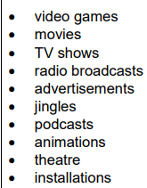
Content Area 4: Sound Creation
Forms of Media
You will have a question about sound creation, so it is important to understand how sound is used for each type of media.
Use the space below (and on the next page) to create mind-maps on how sound is used in the different types of media.
Mood
Movement: footsteps, fighting, doors opening…
Style
Equipment sounds e.g. reloading
Foley
Underscore
Impact
Video games
Spot effects
Lasers etc.
Dialogue & voiceover
Ambience
Explosions
Narration
Instructions
Urban sounds e.g. traffic
Wind, rain
Conversations
USE THIS WAGOLL TO IMPROVE YOUR OWN MINDMAPS
35

Slide 30
Content Area 4: Sound Creation
Forms of Media
36

Slide 31
Content Area 4: Sound Creation
Types of Sound Creation
1. Match the description to the type of sound creation.
Foley
Atmospheric sounds e.g. rain
Ambience
The reproduction of everyday sounds using props
Dialogue
Voice-overs
Narration over what is happening on-screen
Underscore
Specific hard-to-recreate sound events e.g explosions
Spot effects
Characters speaking to one another
Revision tip: think about how sound is produced in each of these types. What are benefits/disadvantages of different methods?
The music underpinning the action
2. Evaluate the advantages and disadvantages of both using commercial libraries for foley and creating your own.
Commercial libraries: An advantage of commercial libraries is that the sounds are readily available, so they are much less time consuming to use than creating your own. Another advantage is that, as they are a paid-for resource, it is likely they will be of a reasonably good standard. A disadvantage of using commercial libraries is that you have to pay for the foley, which may cost more than creating your own. Another disadvantage is that the foley provided is not custom-made for what you are using it for, therefore it may not fit or may require editing to get it to match what is happening on-screen.
Creating your own: An advantage of creating your own foley is that it is custom-made for your use. This way, you can guarantee that it fits your purpose and will also sound more unique. Disadvantages of creating your own foley are that it is time consuming as you must prepare recording equipment and source foley materials for props, and potentially costly, if you need to purchase recording equipment and materials for foley props.
37

Slide 32
Content Area 4: Sound Creation
Types of Sound Creation
1. Use the keywords below to answer the following questions about sound arrangement..
Layering
Texture
Mood
Style
Impact
Non-diegetic
Diegetic
A) Composers may consider the style, e.g. a film set in 1930s Chicago may feature jazz music.
Different layers of sound build up a thick texture.
Composers should consider the mood of a scene when composing.
Composers should consider how they want to impact the audience.
Using more than one recording to build up a realistic sound is called layering .
Two characters listening to the radio in a film scene is an example of diegetic sound.
An underscore is an example of non-diegetic sound.
Exporting Sound Creation
Use this space to mind-map different file types used in exporting sound creation, especially video formats.
Use the bottom-right corner of page 25 in your knowledge organiser to check & improve your mindmap.
Revision tip: have a think how synthesisers and samplers may be used in different sound creation contexts. It is possible you will be asked.
38

Slide 33
Content Area 5: Multitrack Recording
Key exam questions:
Name and explain recording equipment
Name and explain mixing techniques
ANALYSE A MIX < - this will likely be your 12-mark question.
This is almost guaranteed, big-mark stuff!
39

Slide 34
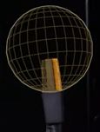
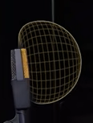
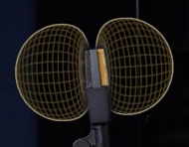
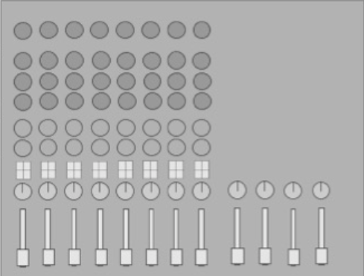
Content Area 5: Multitrack Recording
Equipment
1.Identify the polar patterns.
A) Omni-directional
B) Cardioid
C) Figure of 8
2. What might you record with each of these polar patterns?
A) Room-mic/ambience
B) Single sound source
C) Podcast/duet
3. Phantom power is required by condenser/dynamic mics (underline correct answer).
4. Balanced/unbalanced audio reduces noise (underline correct answer).
5. Label the different parts of the mixing desk.
Channel fader
EQ
Pan
Gain
Aux sends
Master fader
6. Define overdubbing: Recording additional parts over existing recorded parts.
7. Give two benefits of overdubbing: can layer parts/all musicians do not have to record a perfect take at once.
Which control on the mixing desk would you use if the signal was too quiet or distorting?
Gain.
9. A pop shield boosts volume/reduces plosive sounds/widens panning (underline correct).
10. You are going to record vocals. Name three pieces of equipment for the control room and three for the live room.
Control room: PC/mixing desk/speakers/headphones
Live room: Microphones/XLR cables/ ¼” jack cables/mic stands & clips/headphones/instruments/pop shield
40

Slide 35
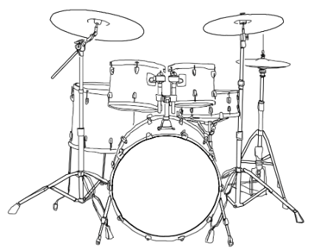
Content Area 5: Multitrack Recording
Planning recording sessions
Name three job roles that work in the studio.
Producer, musical artist, engineer, technician
2. Recording sessions usually are booked for a set number of hours. Identify why this might cause problems.
Musician needs more time to record good take/technical problems with gear.
3. To work out how long you need to record a song, what questions might you ask the artist?
i ) How long is the song?
ii) How many instruments are you going to record?
iii) Do you want to overdub or layer any parts or record all at once?
4. Draw how you would mic up this drum kit. Label all the equipment; include whether you would use dynamic or condenser mics; and which polar patterns you are using.
Refer to p.35 of your knowledge organiser.
41

Slide 36

Content Area 5: Multitrack Recording
Planning recording sessions
5. Draw how you would mic up vocals. Label all the equipment; include whether you would use dynamic or condenser mics; and which polar patterns you are using.
Condenser or dynamic mic?
Pop shield?
Shock mount?
Mic stand
Reflection filter?
What are the distances?
Refer to p.38 of your knowledge organiser.
Mixing
6. Choose three instruments, explain where you would pan them and why.
Instrument | Panning | Reason
Vocals | Central | Because the melody is the focus point.
Overheads | Hard left/right | To recreate the stereo image of the drum kit.
Bass | Central | To provide balance to the music.
7. Which one of these is NOT a way to remove unwanted audio? Underline.
Noise gate Compression Automation
8. Which plug-in can you use if you have pitch errors? Pitch-correction/autotune
9. A drum recording has a few hits out of time. Which of these is a solution?
Use EQ Use pitch correction Cut out the hits and place them in time
10. What does EQ stand for? Equalisation
11. In EQ, what does Q control? The range (or ‘width’) of frequencies affected.
42

Slide 37
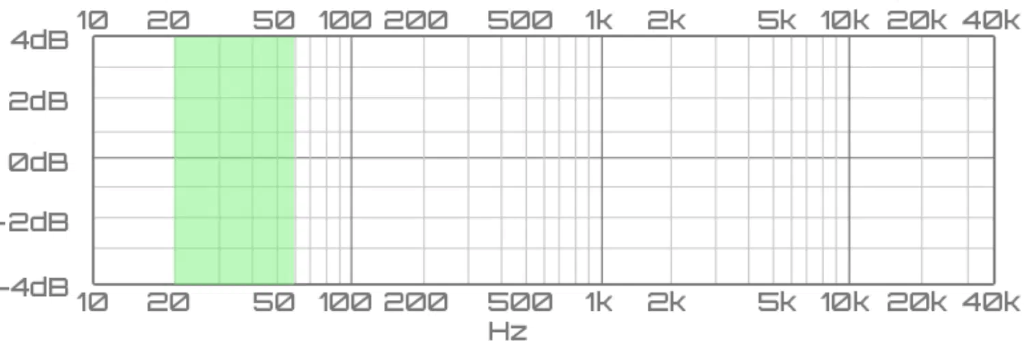
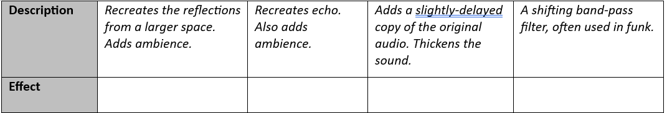
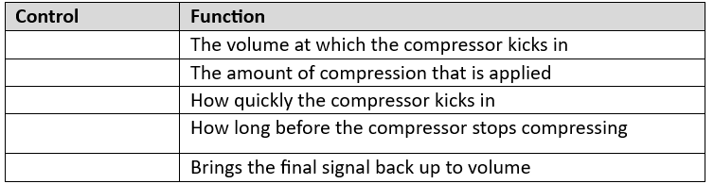
Content Area 5: Multitrack Recording
Mixing
12. On the EQ graphs, draw high-pass, low pass & band pass filters.
High-pass filter
Low-pass filter
Band-pass filter
13. Name the effect being described.
Reverb
Delay
Chorus
Wah-wah
14. Why might you use an amp simulation plug-in?
To get a tone that you can adjust, even after finishing recording.
15. Identify the different controls of a compressor.
Threshold
Release
Threshold
Ratio
Gain
Attack
Ratio
Attack
Release
Gain
43

Slide 38
Content Area 5: Multitrack Recording
Mixing
16. Why use noise gate? To remove unwanted background noise.
17. What does a limiter do? A brick-wall compressor that does not allow volume above a set threshold.
18. Which function would you use to gradually increase reverb length over time?
Automation Reverse Copy & paste
19. When you are mixing, why is it important to listen to mixes on a range of speakers and headphones?
To ensure the mix sounds good on a range of speakers, not just the one you’re mixing on.
20. Why is it useful to listen to reference mixes when mixing? So that your mix fits other examples within the genre or to remind yourself of common practice, e.g. bass level or use of effects.
21. What are the minimum sample rate and bit depth for quality audio?
Sample rate: 44.1kHz
Bit depth 16
22. Name an:
Uncompressed audio file type: WAV or AIFF
Compressed audio file type: MP3
44

