Slide 1
NCFE Level 1/2 Music Technology
Knowledge Organiser

Slide 2
Contents
Content Area 1…………………………………………………………………………………...........1
  Roles and Responsibilities………………………………………………………...........2
  The Development of Music Technology…………………………………………….4
  Consumer Audio Formats………………………………………………………………….6
  The Music Business……………………………………………………………….............7
Content Area 2: The Digital Audio Workstation (DAW)……………………………….9
Content Area 3: Musical Elements, Musical Style and Music Technology….14
  Musical Styles………………………………………………………………………………….15
  Harmony………………………………………………………………………………………….17
  Instrumentation………………………………………………………………………………18
  Melody…………………………………………………………………………………………...20
  Rhythm……………………………………………………………………………………........22
  Structure and Form…………………………………………………………………………23
Content Area 4: Sound Creation……………………………………………………………….24
Content Area 5: Multitrack Recording………………………………………………………28
  Mixing…………………………………………………………………………………………….31

Slide 3
Content Area 1: Introduction to Music Technology and the Music Business
Component Number | Component
1.1 | Roles and responsibilities
1.2 | Development of Music Technology
1.3 | Music business: 1.3.1. Marketing 1.3.2. Promotion 1.3.3. Selling and distributing music
What do we learn?
We learn about the roles and responsibilities that make up the music industry so we understand what jobs are available.
We learn about the development of music technology so we understand the equipment we are using.
We learn about the music business so that we understand how the music business functions.
1

Slide 4
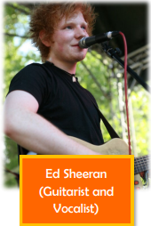

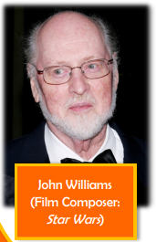
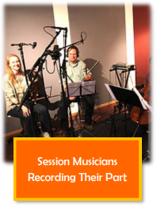
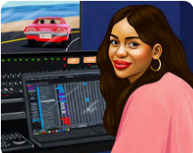
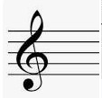

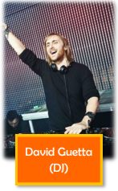
Content Area 1 – Music Technology and the Music Business - Knowledge Organiser
Roles and Responsibilities
Roles: Arranger
Definition:
Someone who takes partially or fully composed pieces of music and changes the way that instruments or parts are played or interact with each other through changes in instrumentation, texture and genre.
For this content area you must understand the following roles:
Musical artist
Composer
Songwriter
Lyricist
Arranger
Session Musician
Sound Designer
Roles: Musical Artist
DJ
Producer
Technician
Engineer
Manager
Publicist
Artist and Repertoire
Responsible for:
Working with composers, songwriters and musical artists to help them arrange their musical ideas.
Responsibilities: creating, developing, rehearsing and performing musical material.
Quincy Jones worked as producer and arranger for Michael Jackson’s 1982 album Thriller.
Roles: Composer
Roles: Session Musician
Definition:
A composer is someone who writes and creates music.
Responsible for:
They are responsible for creating music. However, they are not always the same person as the musical artist.
Many musical artists have composers who they work alongside to help them create their music.
Composers may have to write to a brief or in a certain style.
Definition:
This is someone who plays at least one instrument to a professional standard.
They are hired to perform for recordings or live performances.
Responsible for:
They are responsible for learning instrumental parts and performing them correctly.
They may also be involved in the song writing process.
For example, a guitarist may change how a solo section is played.
Roles: Songwriter
Definition:
A songwriter is very similar to a composer. The difference being that they will be writing songs that have lyrics.
Responsible for:
They are responsible for creating music. However, they may be a separate person to the musical artist.
Many musical artists have songwriters who they work alongside to help them create their music.
Roles: Sound Designer
Definition:
Involved with the production and manipulation of sounds. They usually work within the theatre and media industry. A Foley Artist is an example of a job in the sound designer role.
Responsible for:
Creating and recording sound effects for films, television, video games and live theatre.
Rihanna’s Umbrella (2007) was written by producer and songwriter The Dream.
Roles: Lyricist
Role: DJ
Definition:
A person who writes lyrics or poems that are intended to be used for songs.
Responsible for:
They are responsible for writing the words that will be set to music. They will work alongside the composer/songwriter that is writing the music.
Definition:
DJ stands for Disc Jockey. DJs play music on turntables, using vinyl, CDJs or USB DJ controllers. They have to prepare sets of songs that fit well together, and blend them together into one seamless set by using techniques like filtering, scratching, looping and effects.
Responsible for:
The selection, playback and performance of music in a venue.
Elton John worked with lyricist Bernie Taupin on hits such as ‘Your Song’ and ‘Rocket Man’.
2

Slide 5
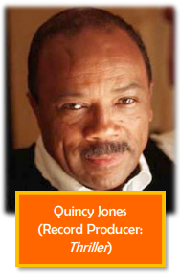
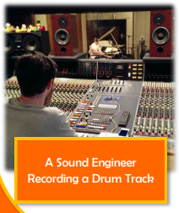
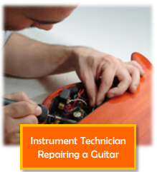
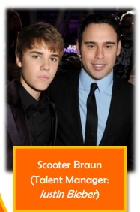

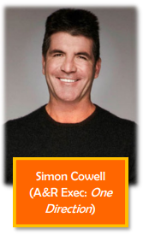

Role: Producer
Content Area 1 – Music Technology and the Music Business
Definition:
Someone who is in charge of leading and directing a musical project.
Their role is similar to that of a film director.
Responsible for:
Overseeing and leading projects
Developing and arranging material
Helping to realise the artists’ vision
Making/creating decisions
Role: Engineer
Definition:
More commonly referred to as a recording engineer, they are in charge of setting up and managing the technical aspects of the recording.
They do not usually make creative decisions; this would be the responsibility of the producer.
Responsible for:
The set-up of recording hardware and software.
Nil Rodgers, the guitarist from Chic, is also a producer who has worked with Madonna and Daft Punk
Technical aspects could include:
Setting up microphones
Placement and positioning of microphones
Setting up the audio interface or mixing desk
Setting up the recording project in the DAW
Managing playback and basic audio editing
Role: Technician
Definition:
This is someone whose main area of expertise is with the maintenance of musical equipment. They may work within a venue, recording studio or a touring company.
Responsible for:
Maintaining and repairing equipment.
If a band were to go on a tour, they would require technicians to look after their equipment so that they can focus on performing. Guitarists will often have a team of technicians who will restring and make set-up adjustments on their guitars, as well as maintain their amplifiers and pedals.
Role: Manager
Definition:
This is a person or team, who are in charge of the business side of an artist’s career. Managers work on commission, this means that they take a percentage of the artist’s earnings in return for managing them.
Responsible for:
Negotiating contracts;
Finding opportunities for clients;
Overseeing the career development of clients.
A technician could also be responsible for the maintenance of other instruments such as:
Bass Guitar
Piano/Keyboard
Synthesisers
Orchestral instruments (Violins, Trumpets, Saxophones)
They may also be involved in making repairs to other equipment such as microphones, smoke machines and lights.
Public Relations
This is the relationship between the musical artist and the public.
Role: Publicist
Definition:
This is some who deals will any public relations. They will often be referred to as a PR manager.
Responsible for:
Creating marketing strategies
Running promotional campaigns
Developing public image of clients
Role: Artist and Repertoire
Definition:
More commonly referred to as A&R. These are people who usually work for a record company and essentially are in charge of searching for new talent to sign to their record label.
Responsible for:
A&R representatives are also in charge of developing the artists that they sign.
A big part of their job will be attending open mic events, gigs and networking in different music scenes to discover pre-empt what will be the next big hit.
Increasingly, A&R reps use social media/the internet to find talent.
3

Slide 6
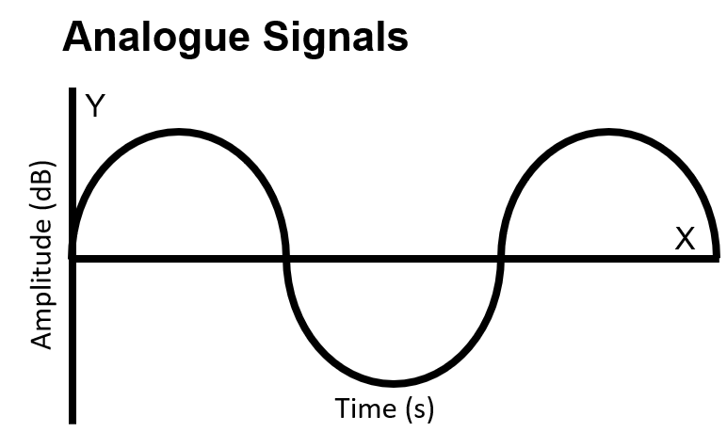
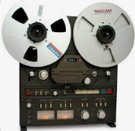
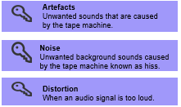

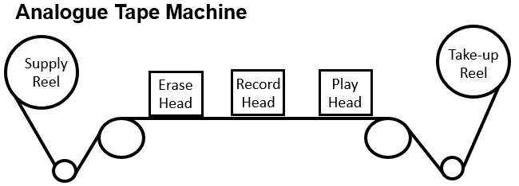
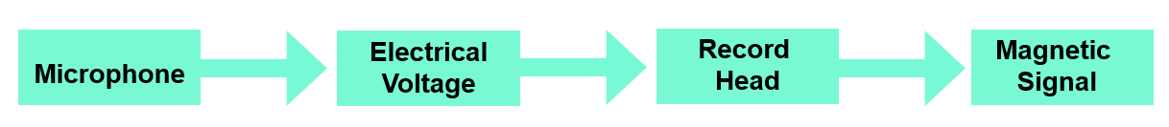
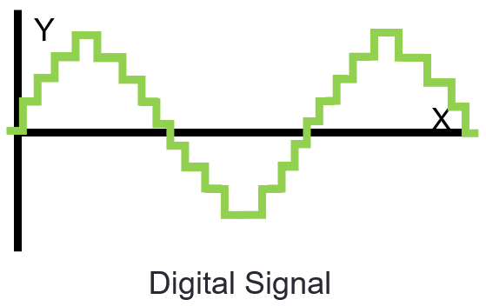
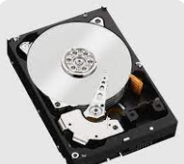
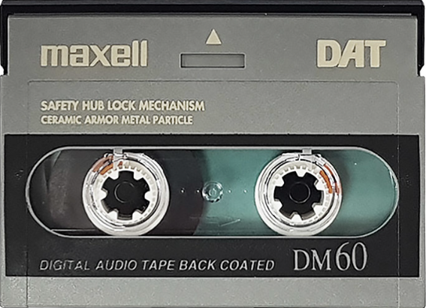

The Development of Music Technology
Content Area 1 – Music Technology and the Music Business - Knowledge Organiser
The History of Analogue recording
Analogue recording
Early tape machines initially only allowed for 1 or 2 tracks to be recorded to them.
So the quality of early magnetic tape recordings was often not very good.
There would be lots of unwanted noise, distortion and artefacts.
Direct to tape: c.1930 - 1963
2-track recording became possible in the 50s.
This made stereo recordings possible.
Performers had to be very skilled because tape cost a lot and you had to record everything at once.
Engineers made edits with razors; destructive editing
Analogue: continuous signal
Early Multitrack Recording c.1964-1969
The diagrams here show how tape is recorded to, and listened back to.
You can see that to record, the record head converts the magnetic particles on the tape into a magnetic signal. This is how the music is stored.
To listen back, the play head converts the magnetic signal back into an electrical voltage, which your speakers convert into audio you can hear.
4 track recording became available in the early 60s
8 track recording became available in the late 60s
Reduction mixing made it possible to record instruments in isolation, one at a time.
This is called overdubbing. It makes it possible to record instruments in isolation from each other.
This leads to greater separation of instruments in the mix.
Reduction mixing is where you record three tracks and bounce them onto the fourth. You then erase the first three tracks so you have 3 more tracks to use. Or you could bounce all four tracks onto a separate machine!
An advantage is you can have lots of tracks.
A disadvantage is that reusing the tape causes a loss in quality.
To record using tape:
To listen back to tape:
Digital Recording
Alesis Digital Audio Tape (ADAT): 1992
Magnetic 8-track tape. Uses the same S-VHS tape as a VCR.
You can sync multiple ADATs together (up to 16), giving a total 128 possible tracks.
The ADAT HD24 replaced the original ADAT. This records 24 tracks to hard disk.
ADAT technology is still used in studios to sync different audio interfaces.
A hard disk drive
24 Track Multitrack Recording 1969-1995
Digital Audio Stationary Head (DASH): 1982
Digital tape converts the incoming audio signal into a data stream of binary information (1s and 0s).
This is recorded onto the tape via the record head.
DASH can record 2 channels of audio to ¼ inch tape or 24/48 channels to ½ inch tape.
Advantages: consistent & flat frequency response, high dynamic range.
By the end of the 60s large tape machines were common in most recording studios.
16 and 24 track machines were commonplace.
These new machines used 2-inch tape rather than ¼-inch tape, which dramatically improved the quality of the recordings. There were much fewer artefacts.
Digital: Discrete signal
Hard Disk Drive (HDD)
A hard disk drive (HDD) works like this:
A moving head writes binary data onto a large magnetic disc within the drive itself. In this instance, the head moves rather than the storage media.
HDD is the most common way of storing audio now. It’s small and can store lots of audio.
Advantages of digital recording: no artefacts; flat frequency response; can reuse with no loss of quality, cheaper
Advantages
Each instrument can have its own channel
Full stereo recording
Much better quality.
Less artefacts.
ADAT tape, the same format as a VHS video!
Digital audio tape
4

Slide 7
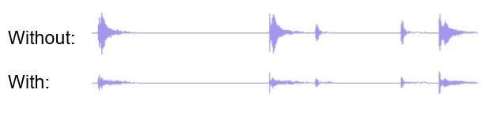
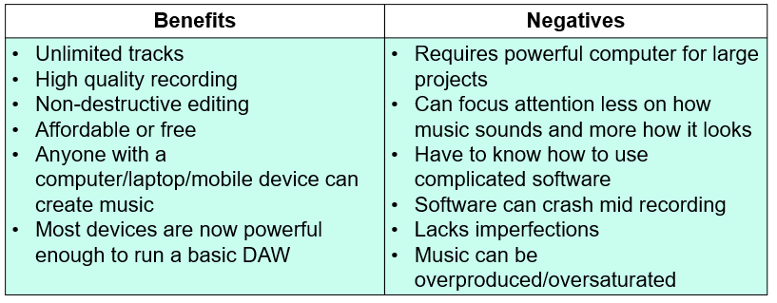
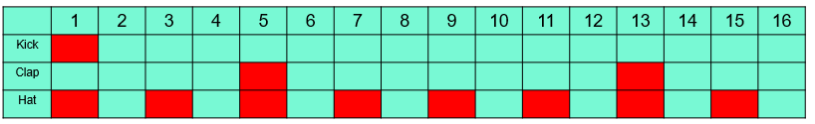
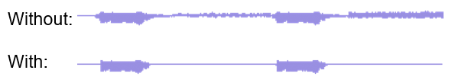
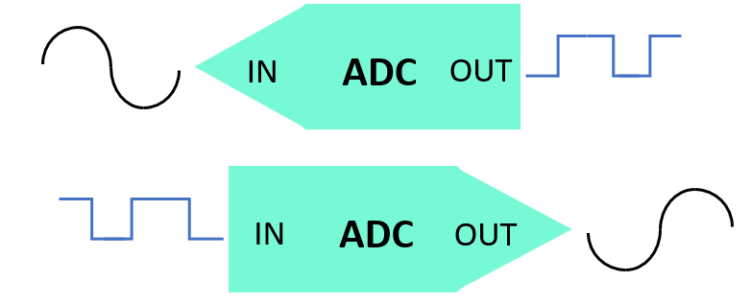
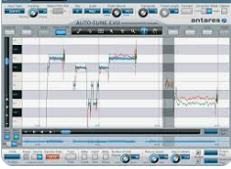
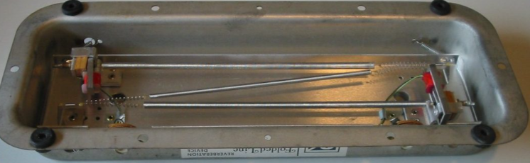
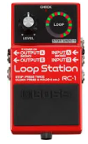
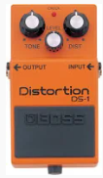
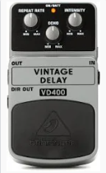
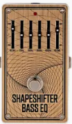
The Development of Music Technology
Electronic Musical Instrument Technology
Dynamic Processors
Digital Recording
Digital Audio Workstation (DAW)
DAWs are the most common way to record now.
They require an audio interface to record.
Initially only 4, you can now have up to 1000 tracks.
You are only limited by the hardware in your computer (poor quality hardware may cause your DAW to lag or crash).
With the affordability of DAWs and free online versions, many people can now produce music.
Drum Machines:
Can program complex drum patterns without being a drummer
Can make sound more natural with humanization/swing features
Compression: evens out the dynamic range of a signal
Sequencing:
Programming information to control an electronic instrument
Step sequencing (below) is dividing a bar into ‘steps’ to program music.
This makes the instruments in a mix sound clearer and stronger because of the consistent volume.
Noise gate: cuts out all sound below the threshold that you set.
Analogue Sequencing
These were hardware sequencers that would send out Control Voltage (CV) data to trigger time and pitch information. This worked by controlling the opening and closing of gates. This allowed one instrument to trigger another.
This is useful for removing unwanted elements in your recording.
Digital Sequencing
Pitch Correction Processors
Analogue-to-Digital Converters and Digital-to-Analogue
DAWs require the analogue signal to be converted to digital so it can process it.
When you want to listen back, we convert the signal back into analogue.
In the late 70s, digitally controlled analogue synthesisers emerged. They also used CV but with computer memory. Sequencers now also began to form a part of the actual synthesiser or sampler.
Autotune is the most famous of these. It measures and automatically corrects the pitches in recordings. You set the key signature and it will snap the notes to the nearest note in that key.
MIDI Sequencing
MIDI became a universal language which meant that any two pieces of equipment regardless of their brand could now control each other. It was a digital signal rather than the analogue signal used by CV control signal. MIDI is now the most common way we sequence music.
Measuring and correcting pitches
Hardware Effects & Processing Technology
Electronic Musical Instrument Technology
Plate reverb: a signal is sent through a sheet of metal, creating a metallic, shimmering sound. A microphone on the other end records it.
Synthesisers:
Use oscillators to produce waveforms (sine, sawtooth, square, triangle
Can be manipulated by:
Envelope (ADSR)
Low frequency oscillator (LFO) which changes another parameter e.g. cut-off filter, tune, noise level
Filter: the most common is a low pass, sometimes called a cut-off filter
Compact Effects Pedals
Spring reverb: similar to plate reverb, except using a spring! It’s smaller so can fit in guitar amps.
Originally designed for guitarists to be used between the guitar and the amplifier.
There are many types, from reverb, delay and distortion to more complex ones. In the mid-1990s, digital effects pedals emerged which are cheaper.
Multi-effects pedals contain many effects and often emulate different amplifiers.
Tape delay: watch this video: https://www.youtube.com/watch?v=QXNoUHdFyrQ:
Samplers:
Trigger prerecorded audio
Samples can be truncated (shortened), mapped across multiple keys, made to loop, layered and tuned
Coarse tuning changes the tuning by semitones. Fine tuning changes the tuning by cents.
Filter: the most common is a low pass filter, sometimes called a cut-off filter
Looping Devices
Loop pedals allow you to record and loop short sections of audio, often guitar or vocals. This has influenced singer/songwriters like Ed Sheeran. Loop capabilities in DAWs like Ableton make it possible to incorporate lots of loops into live performances.
Differences between digital and analogue:
Analogue: warmer sound, more hands-on
Digital: cheaper, more features, more polyphony (more sounds at once)
5

Slide 8

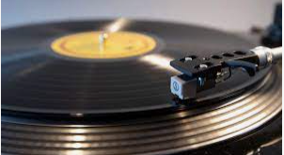

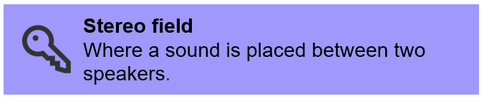



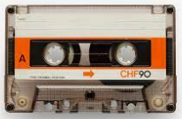
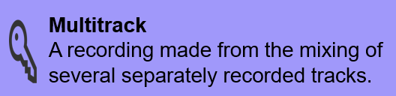

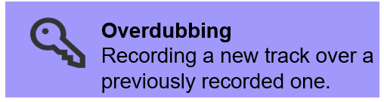
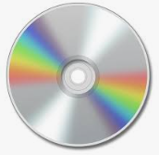
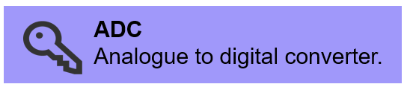

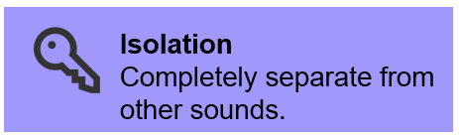
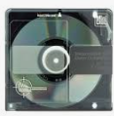





Consumer Audio Formats
The Development of Music Technology
GLOSSARY
VINYL (1930-):
How it works: an analogue storage device. As the record spins, a needle moves through grooves that represent the waveform of the music. This creates an electrical signal which is amplified through a speaker.
Advantages: the first common way of owning music.
‘Coloration’ adds warmth to the sound.
Some like the sound of vinyl defects e.g. noise from dust and pops and crackles.
Disadvantages: cannot store as music on one disc as later formats.
Quality degrades over time.
Can develop scratches that cannot be fixed.
Can warp, becoming misshapen and producing an out of tune sound.
CASSETTE (1963 but popular in the 80s):
How it works: an analogue storage device. Is the same as a tape machine, only smaller.
Advantages: Small and easy to transport.
Could store 1hr of music.
Disadvantages: Quality degrades over time.
Can easily become damaged.
MUSIC VIDEOS (1980s -):
How it works: Dedicated television channels e.g. MTV play music videos. In 2005, YouTube launched providing access to millions of music videos for free.
Advantages:
A good way for artists to promote themselves.
Music channels provided an alternative to the radio for discovering new music.
YouTube can be accessed for free.
Disadvantages: Artists have to be very successful to make any money out of YouTube.
YouTube and music channels make you watch ads.
COMPACT DISC (CD) (1982 but popular late 80s- mid 2010s):
How it works: digital storage device. Music is written to the disc digitally. A CD player head reads the digital information and converts it back into audio. Popular late 80s – mid 2010s.
Advantages: Thin, portable and can store 80 minutes of audio. You could skip between tracks!
Disadvantages: Easily scratched, leading to skips when playing back music or being unreadable by the CD player.
Lightweight plastic cases easily break.
Streaming (2001-)
How it works: Apps host libraries of music on their servers, which you can access online for free or for a fee.
Advantages: Can be accessed on phone, computer etc. without having to buy the music.
Takes up no physical space.
You can access almost any music you wish at no extra cost.
Disadvantages: Artists receive very little in royalties in comparison with physical formats.
MiniDisc (1992) (no longer produced):
How it works: a digital storage device. The same as a CD only smaller.
Advantages: Didn’t scratch or skip easily like a CD. More portable than a CD because of size.
Disadvantages: MiniDiscs and MiniDisc players were more expensive so never really took off because people didn’t want to replace their entire collection.
M-PEG Audio Layer III (mp3)(1999):
How it works: a digital file type. Apple released the iPod in 2001 which meant you could travel with 1,000 songs in your pocket. Advantages: Compressed so can store loads.
Cheaper than physical formats.
Disadvantages: Many prefer the quality of uncompressed audio.
MP3 players were made obsolete by streaming platforms like Spotify.
Digital Versatile Disc (DVD) (1996 -):
How it works: Like a CD but we mainly store videos on it.
Advantages: Can store between 4.7 – 8.5GB of data.
Disadvantages: Have become less popular because of streaming.
6

Slide 9
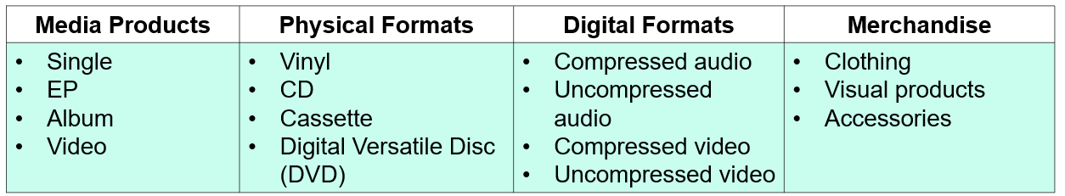
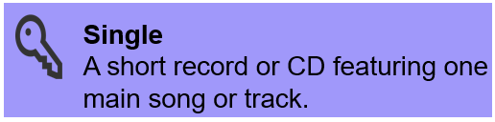
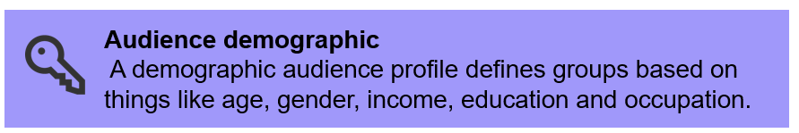
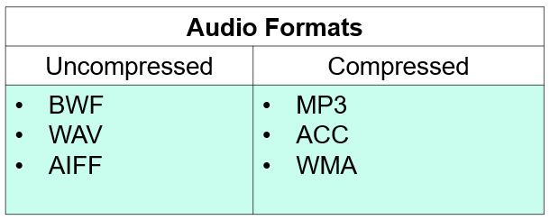
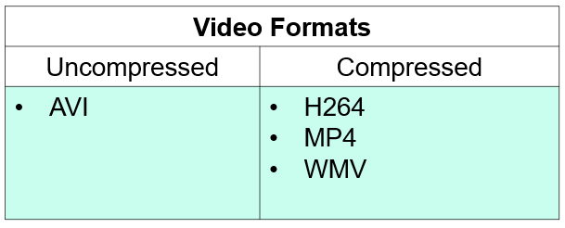

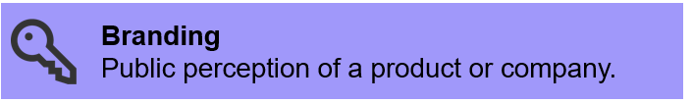

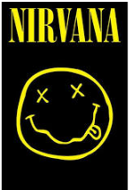
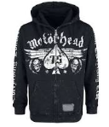

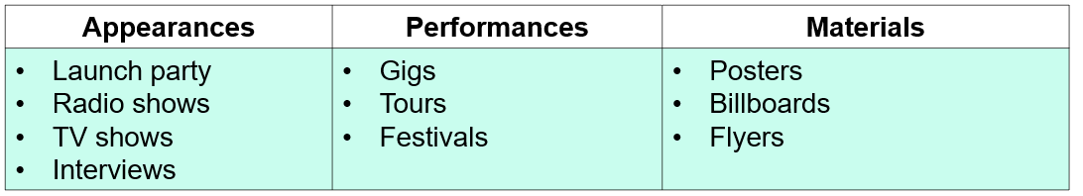
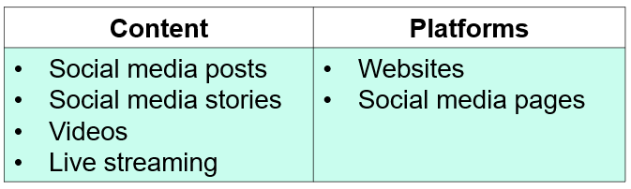

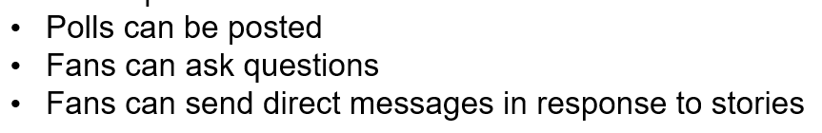
Marketing
Content Area 1 – Music Technology and the Music Business - Knowledge Organiser
Market Research | Branding | Campaign
Audience demographic | Development of the brand Logos Colour schemes | Visibility of musical artists and product
Music Business
Selling Music
Compressed formats:
Different to the dynamic compression you use in GarageBand.
Compressed formats reduce the size of a file by removing information. This may result in worse quality.
Artists release tracks they think are most likely to succeed on singles charts.
This track is featured on the ‘A’ side if it is on7” vinyl.
Bonus tracks/remixes feature on the B-side.
Visual products such as framed posters, autographs and signed photos.
Before putting together a campaign (the process of promoting and releasing a product), it is important to do market research.
By considering the audience demographic (age, gender, occupation etc.), you can focus your branding and advertising to appeal to your audience.
Branding takes into account the appearance of an artists’ social media presence; logos; colour schemes used in promotional material.
Giving questionnaires to (potential) fans is a good way of doing research.
You campaign needs to be effectively managed, with well-planned promotion that is highly visible to the target audience.
EPs are four or five tracks in length.
They are sometimes released in groups of 2 or 3 to form an album.
Album
Often between 10-12 tracks
Used to be called LPs (long plays) on vinyl.
Merchandise
Clothing is often sold at concerts/online.
Videos
One of the most common media products because of YouTube.
Live concerts etc are also released as DVDs.
Accessories such as phone cases, key rings and guitar plectrums.
Physical promotion
Promotion
Content: Videos
Definition:
Usually pre-recorded footage that is then released over time. For example, the lead up to a concert, or footage from recording an album. This gives fans something to regularly be engaged in, that can be shared and re-watched.
Digital Promotion
Materials
What to include:
Promotion company
Artist name/logo
Support acts
Venue
Price?
Date
Time
Where to buy tickets
Website?
Social media?
Promotional images
Content: Live streaming
Definition:
Live streaming is when an artist sends a video feed that is unedited. This will often be scheduled so as many fans will be there to watch. This can be used to announce something special or for a question and answer or short performance. Sometimes these happen unannounced.
Content: Social Media Posts
Social media posts is one of the most effective ways to promote if you have a big following.
This is because it goes direct to your fanbase’s feed, who is likely to check it regularly.
Content: Websites
Artists have their own websites because they can be an easy-to-find platform containing all of the artist’s business; from tour dates to merchandise and recordings.
Content: Social media stories
Digital promotion is very important because it is cheap/free, has a massive global reach and is a very fast delivery medium.
7

Slide 10













Content Area 1 – Music Technology and the Music Business - Knowledge Organiser
Distributing Music
Administrative Services
PRS for Music
(Licenses: Public places, such as bars and restaurants, must pay for a PRS license to play music on their premises.
With a license, these venues can play the music of PRS’ members. PRS Will then distribute the royalties to their artists.)
PRS for Music is a royalty collection and distribution society.
PRS tracks the use of musical works around the globe and then collates this money to then be distributed out to the rights-holder(s).
(Rights-holders: the people who are owed royalties – artists, songwriters, lyricists, composers, record labels)
Manufacturing
There are many ways to produce physical products and packaging, from splattered vinyl to whether the case is cardboard or plastic, and if you include a lyric booklet.
The more copies you order, the better deal you will get. This favours bigger record companies with bigger budgets.
Royalties should be paid whenever a piece of music is performed or played.
This includes:
live gigs, radio play, restaurants or bars, online streams.
Royalties
PRS is about performing royalties, not mechanical or recording royalties.
There are other types of royalties in music:
PPL (Phonographic Performance Limited)
Collect royalties for use of recorded music on behalf of performers and record companies.
MCPS (Mechanical-Copyright Protection Society)
Collects mechanical royalties from when music is copied. E.g. CDs and vinyl.
Shipping
The process of moving products from the manufacturer to the shops (retail) or to record labels/artists to decide where they want to sell them.
Shipping abroad will incur taxes
Retail
If you sell your music through a shop (retailer), they will buy at a lower price and sell at a higher prices.
This means you won’t get all the profit.
You will have the opportunity to reach a wider audience, though.
“We work to maximise the employment and overall income of musicians as well as protecting and improving working conditions. We also offer advice, support and legal assistance based on every individual member’s needs.”
Aggregators
Aggregators do digital distribution: they put your music online in return for a fee or percentage.
Artists/record labels use these to distribute their music on online services such as Spotify and iTunes.
Examples: DistroKid, CD Baby
Musicians’ Union: Benefits
To become a member of the union you will need to pay an annual subscription fee directly to the union.
Membership costs around £20 per month.
However, there are a number of discounts available.
For example:
Disabled musicians’ membership
Joint membership
Student membership
First sixth month discount
Here are a list of benefits that musicians receive:
£10 million public liability insurance cover
£2,000 of music instrument insurance cover
Personal accident cover
Pension scheme
Financial assistance in times of need
8

Slide 11
Content Area 2: The Digital Audio Workstation (DAW)
Component Number | Component
2.1 | 2.1.1. Hardware components 2.1.2. Software functions
2.2 | 2.2.1. Creating audio using a DAW 2.2.2. Health and safety
What do we learn?
We learn about the hardware and software we use with a DAW so we can create our own audio.
We learn techniques to produce our own sound.
We learn about health and safety so we can use the equipment without risk.
9

Slide 12















The DAW (Digital Audio Workstation) is computer software used to record, program, edit and mix music. They can be desktop applications (e.g. Garageband) or cloud-based (e.g. Bandlab)
Content Area 2 (DAW) Knowledge Organiser
Synthesisers
Track types
Hardware is any equipment you can touch.
Software instrument: guitars, pianos, violins etc. You also access the synthesisers and sampler using these.
MIDI (Musical Instrument Digital Interface) is a language that MIDI controllers use to communicate with computers.
The range of values is 0 – 127.
When you press a note, the controller sends 3 main values: pitch, duration and volume.
There are different MIDI controllers – keyboards, pianos, guitars etc.
Software are computer programs that exist on your computer/tablet/phone.
Audio channel: For recorded audio files
Audio Interface
Converts microphone and instrument signals into digital signals so they can be sent to your computer
Synthesisers generate sound waves (sine, triangle, square and sawtooth.
You can combine and control these waves to create your own ‘patches’ or sounds.
Synthesisers can be hardware (MicroKorg) or software (Agile Synth).
Editing
Panning places the sound in the stereo field (left, centre, right)
Quantisation puts notes in time
Automation changes the amount of something (e.g. panning) over time
Velocity: you can edit the volume of MIDI by changing the velocity
EQ (equalization): The process of boosting or cutting frequencies to enhance the audio
Filters
ADSR
(Envelope)
Filters are used to block frequencies out
Attack: The time it takes for the sound to go from silent to full-volume
Q: the width of frequencies affected
Decay: The time it takes for the initial peak to settle
Gain: the amount frequencies are boosted/cut
Sustain: The time the sound can be held for
Release: The time it takes for the sound to die off once the note has been released
Samplers can be hardware (MPC) or software (EXS24). Use samplers to sample and edit audio to use in your own work. You can loop sounds and change their pitch.
Plug-ins
Used to be hardware but are now often software
Include EQ, compression, effects etc.
Dynamics processing
Dynamic range: the range of volumes in audio
Compressors reduce the dynamic range.
To do this, lower the threshold and boost the ratio
Gating cuts out sounds below the threshold you set
Limiting is like a brick wall compressor
MP3: Lossy, compressed audio. Pro: Small files,
Con: worse quality.
WAV/AIFF: Lossless,uncompressed audio.
Pro: Better quality
Con: larger size
Sample rate: the number of samples taken per second. 44.1kHz is the minimum needed
Bit depth: the range of amplitude values available.. 16, 24 and 32-bit are common. The bigger the better.
Exporting audio files
10

Slide 13




Content Area 2 – The DAW
Knowledge Organiser
THE COMPUTER | Function
Operating system | E.g. Windows, Mac OS. The program that manages all other apps
RAM | Random-access memory. Your computer’s short term memory.
Hard drives | Where data is stored on your PC.
Processor | Tells everything what to do, from your display to your disk drives. The higher number in the series, the more processing power you have.
Display | The look of your screen, from brightness to shortcuts
DIGITAL AUDIO WORKSTATIONS (DAWs) | Description
Cloud-based | E.g. Bandlab. Often free to use with fees for extra services.
Desktop applications | E.g. Logic, ProTools. Often used by professionals.
Audio bit depth | To digitize audio, digital converters convert audio into samples of data. The ‘bit depth’ refers to the range of data within each sample. The higher bit depth, the better the quality. 24-bit is common. This results in larger file sizes.
Sample rate | How often a sample is taken in the digital conversion. 44.1kHz is the minimum required. 192kHz is high. Again, the bigger, the better but this means larger file sizes.
Buffer size settings | To record smoothly, reduce your buffer size. Higher buffer settings can increase latency (lag between input and recording). To mix, increase it to avoid crashing.
Stereo tracks/mono tracks | Stereo tracks feature two audio channels (left and right), mono are just one.
EXTERNAL STORAGE | Function
Universal Serial Bus (USB) | Transfers DATA. Keyboard, mouse, external hard drive, audio interface use USB.
Solid State Drive (SSD) | The most common storage drive. Found inn your PC.
Cloud storage | Storing data online reduces use of space on SSDs. Saves automatically.
Network drives | Organisations use network drives for storage, for example the student drive.
A note on MIDI interfaces:
Most MIDI controllers have a MIDI interface inbuilt, meaning you can plug them straight into your computer via USB. These contain MIDI inputs (MIDI IN), outputs (MIDI OUT) and MIDI throughputs (MIDI THRU). Old devices require you to connect an external MIDI interface to connect to your PC. These use a MIDI cable that has a DIN connector – a special 5-pin cable.
AUDIO OUTPUT | Description
Headphones | Mini jack or ¼” jack connection. Good for stereo field and bass frequencies
Speakers | Jack or XLR connection via audio interface.
Examples of MIDI controllers
MIDI CONTROLLERS | Description
MIDI (musical instrument digital interface) | Used to transmit music, e.g. from a MIDI keyboard to a DAW. All values are 0-127 and the main information is pitch, velocity and duration.
MIDI Keyboard | The most common MIDI controller. Connected via USB or MIDI cable.
MIDI guitar, percussion, wind instruments and DJ controllers | Other MIDI instruments. They perform like guitars etc. but you can choose synthesized sounds or transmit the data to another device, e.g. the DAW in your PC.
Control surfaces | The keys of a MIDI keyboard are most common but faders, knobs, pads and data wheels are also featured on MIDI controllers.
MIDI Editing | Definition
Cut, copy, paste | Regular tools used to edit notes in your editing grid
Quantisation | The process that puts your notes in time by snapping them to the grid. You can make quantisation sound more realistic by using humanisation or swing.
Velocity | Volume. Edit velocity to create the feel you want and make the music more realistic.
Pitch bend | Increasing or decreasing the pitch of one inputted note while it plays. This can be inputted using the pitch bend wheel on your MIDI controller.
Controller data | The information send from your MIDI controller to the DAW. This usually contains pitch, velocity and duration but can also contain other information such as pitch bend and vibrato (the effect produced by the vibrato wheel on your controller that produced a rapid variation in pitch of the note you are playing).
AUDIO INTERFACE
Line input: RCA phono cable; ¼” jack, stereo ¼” jack, mini jack
Microphone input: External line return (XLR), ¼” jack, USB
Instrument input: Direct injection (DI) – plug straight in with a ¼” jack
PC connectivity: USB
Speaker output: ¼” jack – balanced or unbalanced
Phantom power: +48v for condenser mics
Gain control: to boost signal
11

Slide 14




Content Area 2 – The DAW Knowledge Organiser
MIXING DESK ARCHITECTURE
Mixing desks can be analogue, digital or a ‘hybrid’ (mix) of both.
On the right-hand side, you will generally find main, headphone and control room volume; phantom power; and, on digital desks, effects. You will also find auxiliary buses: these send signal elsewhere than the main output, e.g. to hardware effects plug-ins.
AUDIO EDITING
AUDIO EDITING TECHNIQUES | DEFINITION
Trim | Shorten the length of an audio region
Reverse | Set the audio to play backwards
Time stretch | Shorten or lengthen the audio so it plays over a shorter or longer time. You can either do this so that it speeds up, slows down or neither.
Pitch manipulation | Change the pitch of audio so it is higher or lower
Mixing desks can be set up as a control surface for a DAW, so that if you, for example, moved the fader on channel 1 on the desk, the fader on channel 1 in your DAW would move accordingly.
HEALTH AND SAFETY | RISK
Exposure to noise | Hearing loss
Use of computer displays/workstations | Eye strain
Slip, trip, fall hazards | Sprains and breaks
Electrical hazards | Electrocution
Reporting hazards and accidents is an important part of the health and safety process within your workplace. There may be a health and safety manager in your workplace; the team responsible for maintenance may carry out work; a leader in your workplace will have a responsibility for health and safety.
EFFECTS PLUG-INS
Reverb: the sound of a larger room
Delay: echo
Chorus: created by having two versions of the same audio, one at a slightly different pitch. Creates that underwater sound
Flanging: created by having two versions of the same audio, one slightly out of sync. Creates that ‘aeroplane taking off’ sound
Phasing: filters peaks and troughs into the frequency spectrum, sounds similar to flange
Wah-wah: a filter effect used a lot in funk, disco and rock music
Amp simulation: Inbuilt features of DAWs and some amps that create the sound of other amplifiers
Overdrive: A distortion effect
Risk assessment: identifying hazards and implementing measures to control them. For example, identifying the risk that there is a room without a fire alarm and putting in the control measure of installing one. A form will be completed like the one below.
Audio interfaces
12

Slide 15





Audio Interface
Signal Flow
XLR input
Audio Interfaces
MIDI Controller Controls
Content Area 2 – The DAW Knowledge Organiser
13

Slide 16
Content Area 3: Musical Elements, Musical Style and Music Technology
Component Number | Component
3.1 | Musical Elements: 3.1.1. Structure 3.1.2. Form 3.1.3. Melody 3.1.4. Harmony 3.1.5 Rhythm 3.1.6. Instrumentation
3.2 | 3.2.1. Musical Elements and styles 3.2.2. Musical Styles and technologies
What do we learn?
We learn about the different elements of music so we can control them in our own work, and identify them in examples.
We use the elements of music to define different styles of music.
We learn about how technology has influenced the development of different music styles so we can understand the link between technology and composition.
14

Slide 17















Content Area 3: Musical Styles
Rock and Roll
1950s
Funk
1970s
Artists:
Elvis Presley, Chuck Berry, Little Ritchie
Artists:
James Brown, Average White Band
Decade | Artists
1950s | Elvis Presley, Chuck Berry, Little Ritchie
1970s
Artists:
Donna Summer, The Bee Gees, Chic
Disco
Rock
1970s
Reggae
1960s -
Artists:
Bob Marley, Junior Murvin, the Heptones
Folk
Artists:
The Who, The Kinks, The Beatles
1960s -
Electronica
Artists:
Bob Dylan. Simon & Garfunkel
1960s
Artists:
Daft Punk, Moby, Portishead
1980s
Soul
Artists:
Aretha Franklin, Sam Cooke
15

Slide 18






Hip Hop
2000s -
1980s -
21st Century Pop
Artists:
Grandmaster Flash, Run-DMC, LL Cool J
Artists:
Adele, Lady Gaga, Beyonce
Decade | Genres | Tech benefits
1950s | Rock n roll | Electric guitar: amplification, volume & tone control Bass guitar: smaller than double bass, volume and tone control 2 track recording: overdubs, layering and separation
1960s | Folk, rock, soul | 4 & 8 track recording: more opportunity for layering, overdubbing & separation Hardware effects: e.g. spring reverb create better mixes Analogue synthesis: available for artists to experiment with
1970s | Funk, disco, reggae | Drum machine: complex drum patterns and quantisation Analogue sampler: available for artists to experiment with 16 & 24 track recording: high level of separation and layering possible
1980s | Hip hop, electronica | Digital sampler: tools such as pitch-shifting and looping are easy Digital tape recording: safer storage and can store lots of audio, quality is easy to preserve Digital synthesis: wider range of effects and manipulation possible MIDI: backing tracks easily created Portastudio: Recording affordable in home studios
1990s | Dance | Hard disk-based recording: storage/transfer becomes easier and quality doesn’t deteriorate Keyboard workstation: wide range of keyboard functions
2000s | 21st Century Pop | DAW: access to plug-ins, automation & tempo tracks and reduces need for hardware Audio processing plug-ins: create high quality FX, EQ etc. without need for hardware Analogue hardware revival: Old-skool hardware FX become cool for vintage sound Software emulation: It becomes possible to recreate almost any technology without cost and space of hardware
Dance
1990s -
Artists:
Grandmaster Flash, Run-DMC, LL Cool J
The development of technology
16

Slide 19






Identifying The Tonality…
Tonal - In a major or minor key
Atonal - There is no sense of key
Modal - Uses ‘old-fashioned’ scales called modes
Pentatonic - The music only uses 5 notes
HARMONY
Chords
Triad - A chord with three notes (See left)
Power Chord – Only playing the Root and Fifth of a triad (used in Rock music)
Chord Sequence - The order the chords in a piece of music follow
Primary Chords - The three most commonly used chords used in music: I, IV, V
Secondary Chords - The other chords: ii, iii, vi, vii
Modulation
Musical word for key change. Most common changes: to Dominant or relative Major/Minor.
Triad A Chord with three notes:
5th
3rd
Root Note
Scales
Diatonic
Music only uses notes that are found in the key signature of the piece
Chromatic
Music uses the notes found in the key of the piece but also adds in extra accidentals (# / b)
C, E, G
C, Eb, G
C, Eb, Gb
C, E, A#
C, E,G, B
C, Eb, A, Bb
Suspended chord: A chord where the 3rd (middle note) is replaced with a perfect 4th or major second.
E.g. C major – Csus4=
C – E –G changes to C – F -G
Chords in the major keys
Inversions Changing which note of a chord is the lowest sounding:
Root Position 1st Inversion 2nd Inversion
17

Slide 20



INSTRUMENTATION
INSTRUMENT FAMILY | INSTRUMENTS | METHODS OF PERFORMANCE
Strings | Violin, viola, cello, double bass, guitar | If it has strings, it’s strings. Plucked: played with the fingers Bowed: played with a bow
Percussion | Drum kit, xylophone, glockenspiel, steel drums | If you hit it, it’s percussion. Tuned: tuned to pitches, e.g. xylophone Untuned: not tuned to pitches e.g. drum kit
Keyboards | Piano, organ | Played by pressing a key which moves a hammer that hits a string
Brass | Trumpet, trombone, tuba, French horn | Valved: valves are pressed or left to open to control the pitch (e.g. trumpet) Slide: pitch is controlled by a slide (e.g. trombone)
Woodwind | Flute, saxophone, oboe, clarinet, bassoon | Reeds: saxophones, oboes and clarinets create sound by blowing on a reed – a thin piece of wood Flutes create sound by blowing over a hole
Vocals | … | Lead: sings the main melody Backing: sings harmonies and additional vocals
Samplers can be hardware (MPC) or software (EXS24). Use samplers to sample and edit audio to use in your own work. You can loop sounds and change their pitch.
Synthesisers
Synthesisers generate sound waves (sine, triangle, square and sawtooth.
You can combine and control these waves to create your own ‘patches’ or sounds.
Synthesisers can be hardware (MicroKorg) or software (Agile Synth).
18

Slide 21






Electric Guitar and electric bass
Became popular: 1950s
Family: strings
Associated styles:
Rock ‘n’ roll
Folk
Rock
Reggae
Funk
Soul
Advantages:
Can amplify – can be heard above other instruments
Tone control through pickup selectors/tone controls
Can apply effects through amplification such as distortion/fuzz, reverb, delay, wah wah etc
Drum machines
Became popular: 1980s
Associated styles: hip hop, disco, dance music, electronica, 21st century pop
Features:
Can use samples
Can use quantisation
Can use recording/layering feature to create complex drum patterns
Can use swing/humanization features to sound more realistic and have better groove
Can achieve clear sound without much mixing
DJ Turntable
DJ Mixer
CDJ
DJ mixers are used to connect, mix and output the sound from turntables or CDJs. There are various controls above you can use to mix the tracks together and monitor levels.
DJ software
Pitch control adjustment: speed up slow down the music, will also increase/decrease the overall pitch of the music.
The tonearm: holds the needle which picks up the grooves in the vinyl record.
The 45 adaptor: moves the tonearm in place for 7” (smaller) records. Called so because this is for 45rpm records, which are 7 inches in diameter. Regular vinyl is 12” in diameter.
The speed selector controls how fast the platter rotates. You need 33 1/3 rpm for regular size (12”) vinyl and 45rpm for smaller (7”) vinyl.
Originally developed in 1994, CDJs make it possible to DJ using CDs, and also now you can import your music onto CDJs using USB flash drives or SD cards. The mixer usually has the same features as a vinyl turntable but often with extra features such as looping and beat analysis. Additionally, some CDJs can be used with DJ software on a PC/laptop. This means you play the music from your PC but control it using the CDJ, like a ‘DJ controller’.
There is a massive number of DJ software programs available today, from Traktor to Serato. There are all the usual turntable features as well as a range of effects, cueing and looping tools. You can also control the software interface with a USB DJ controller or a CDJ. Additionally, you can use the music stored on your computer drive or stream the music from streaming platforms such as Soundcloud.
19

Slide 22














MELODY
Notes of the Stave
MELODIC FORMS
INTERVALS
Tone (T): an interval (distance) of two notes apart. E.g C -D
Semitone (S): an interval (distance) of one note apart.
E.g C – C#
Intervals:
1 note = second
2 notes = third
3 notes = fourth
4 notes = fifth
5 notes = sixth
6 notes = seventh
7 notes = octave
Arch form: the notes of the melody form an arch.
MELODIC DEVICES
Inversion: travelling up/down the scale by the same interval but in the opposite direction (upside down).
C major scale
D major scale
E major scale
Here are the SCALES you need to know. See if you can work them out/play them on piano or guitar.
Retrograde: reversing the order of the notes so they appear backwards
T+S: You’ll see this in the harmonic minor, minor pentatonic and major pentatonic. It is a tone + a semitone (3 notes). For example, E-G.
20

Slide 23



USEFUL STUFF
Intervals Major scale
Unison
Major 2nd
Major 3rd
Perfect 4th
Perfect 5th
Major 6th
Major 7th
Octave
Intervals minor scale
Unison
Major 2nd
Minor 3rd
Perfect 4th
Perfect 5th
minor 6th
minor 7th
Octave
Bass Clef notes
21

Slide 24








RHYTHM
22

Slide 25



STRUCTURE
FORM
Intro
Might feature verse/chorus chord progression, stripped back instrumentation
Through-composed
A
B
C
D
E
Verse
Chords repeat, lyrics change. Tells the story of the song
A
D
A
C
Chorus
New chord sequence. Lyrics repeat every time. Often loud dynamics, full instrumentation. Might contain the name of the song.
Arch
B
Rondo
B
C
B
A
Pre-chorus
Build-up section before a chorus.
A
A
Binary
Refrain
A repeated lyric
A
B
Ternary
Breakdown
Section where parts are stripped back. Often solos.
B
A
Strophic
A
A
A
A
A
Coda
Brings the song to an end. Different to an outro.
Drop
The end of a build-up section.
12 Bar Blues
Riser
A sound that rises in pitch or volume
A chord sequence used in blues, rock ‘n’ roll and rock. The Roman numerals represent the chords. (It sometimes ends with chord V or V7)
Bridge
Either a pre-chorus or middle 8.
Here is an example of the 12 bar blues in C.
Genre | Typical structure/form
Rock ‘n’ roll | 12 bar blues
Rock | Verse/chorus, 12 bar blues
Folk | Verse/chorus, strophic
Dance | Through-composed, binary, verse/chorus
Hip hop | Strophic, verse/chorus
23

Slide 26
Content Area 4: Sound Creation
Component Number | Component
4.1 | Sound creation: 4.1.1. Forms of media 4.1.2. Types of sound creation 4.1.3. Methods of sound creation 4.1.4. Arranging sounds 4.1.5 Exporting sound creation
What do we learn?
We learn about how sound is used in different types of media, so that we can create our own.
We learn how to produce sound using different types and methods, so we can create sound for media.
We learn how to arrange and export our sound creations, so that we can deliver a finished product.
24

Slide 27









Content Area 4: Sound Creation Knowledge Organiser
Video games | Movies/TV Shows | Radio broadcasts | Advertisements | Jingles | Podcasts | Animations | Theatre | Installations
How sound is used.
To provide feedback – tell the user if they are doing well. To provide gameplay cues – e.g. someone is attacking you from behind. To drive emotion – e.g. music to get you excited. Underscore Foley & spot FX Dialogue | Underscore: mood, style and impact Foley Special FX Online sound libraries Ambience Voiceover/dialogue | Playlists – created by radio stations. DJs select most of their music from these. Sound FX – used to make the show more exciting, e.g. window smashing sound in a rap show. Microphones Theme/jingle | Voiceover Foley Underscore Jingles are the most unique feature of sound for adverts. They are short, catchy melodies, usually without backing, e.g. the McDonald’s whistle. | Used in adverts on TV and radio etc., these are short, catchy melodies (usually set to a slogan) that identify the brand. The shorter and catchier, the better. | Sound FX Microphones Theme/jingle Underscore/backing music Music often accompanies the introductions and outros to podcasts. It helps give the podcast structure and is memorable. | Foley and special FX are often more exaggerated, unusual or silly to emphasise actions. Sometimes things that don’t actually make sound (e.g. movement through air) are given sounds. Underscore Voice acting – not to be confused with voiceover. | Physical props can create natural sound Props can be used musically Props can be used onstage to represent actions Props recorded off stage represent actions Foley to represent onstage actions Special effects can be used | Physical props can be used to create sound Props can be automated to move mechanically, creating sound without humans Recordings/samples can be played back Audience may interact with the installation
Performed and recorded by foley actors on a soundstage.
The music underneath the action.
The atmospheric sounds that make a place sound more real, e.g. crowds, traffic, coughing…
Revision Tips
You should understand the different types of sound creation and methods of sound creation .
You should understand which of these are used for different media, e.g. films/podcasts/theatres, as well as HOW and WHY.
You should know the advantages & disadvantages of using different types/methods of sound creation.
Composers consider mood, style and impact.
The reproduction of everyday sounds, e.g. ice clinking in a glass, using props.
Underscore
Ambience
Foley
Can be recorded or sourced from online sound libraries, though you may have to pay royalties.
Types of Sound Creation
Exporting video files
How to render audio to video:
File > movie > export audio to movie
The conversation spoken between characters.
Dialogue
MP4: A smaller type of video file because more compression is used, making it easier to store and stream but possibly worse quality.
MOV: A larger type of video file. Less compression is applied which makes for better quality.
Spot effects
The reproduction of difficult sounds e.g. explosions.
Voiceover
Can be recorded on set or dubbed later.
Exporting audio files
Sample rate: the number of samples taken per second. 44.1kHz is the minimum needed
Bit depth: the range of amplitude values available. 16, 24 and 32-bit are common. The bigger the better.
WAV/AIFF: Lossless, uncompressed audio.
Pro: Better quality
Con: lower quality
MP3: Lossy, compressed audio. Pro: Small files,
Con: worse quality.
Can be created using synthesis.
The narration of a movie/TV show/podcast/advert etc.
Is not heard by the characters.
25

Slide 28






Content Area 4: Sound Creation Knowledge Organiser
Physical Props
Not to be confused with props in drama.
Physical props are used to recreate sounds.
Anything can be used, e.g. coconut shells for the sound of horse hooves.
Once they’ve been recorded, they need to be edited in a DAW to be the correct length and in time with the action on screen.
Methods of Sound Creation
Environmental Sounds
Can be recorded with portable recording hardware, e.g. motorway traffic or wind.
Other sounds, e.g. coughing, can be recorded in the studio.
After choosing the best audio, it needs to be edited in the DAW to match the action.
Sound synthesis
A preset on a synth is called a patch. Patches come preloaded on synths or you can create your own. You can save your patches to reuse them.
Select and combine waveforms (sine, sawtooth, square and triangle).
Use filters (high/low/band pass) to remove unwanted frequencies
The low frequency oscillator (LFO) makes certain things (e.g. pitch or filter) change rapidly or slowly.
Use the envelope (ADSR) to fine tune your sound.
(Synthesisers can be used for a wide range of tasks, from creating bass sounds and arpeggios to making sound effects for film/TV/theatre etc.
This is because you can build a synth patch from scratch, adding noise, LFOs and other techniques to create really interesting sounds.)
Digital Sample Manipulation
Just like on a synth, you can create patches (that you can save) in a sampler
First, you need to know how to import audio into the sampler.
Will you use lots of different samples and map them to different keys, or map one sound over all keys?
Use the loop function to make your sounds repeat. You can also detune and pan.
See the next page for more info about GarageBand’s sampler
ADSR (Envelope)
Effects Libraries
Attack: The time it takes for the sound to go from silent to full-volume
.
Commercial libraries
You can purchase bundles of sound effects from effects libraries but may have to pay royalties for their use, and others may use them.
Online resources
Some sound effects are available on online sound libraries, but these may require payment/royalties and may not be the best quality
Decay: The time it takes for the initial peak to settle
Sustain: The time the sound can be held for
Release: The time it takes for the sound to die off once the note has been released
DAW Loops
DAWs often provide a set of prerecorded effects, e.g. a crowd roaring. These are good quality but there is often a small range of sounds.
Filters
Filters are used to block frequencies out
DAW Arrangement tools | How to use
Video file import | File > movie > open movie
MIDI file import | Download the MIDI file, then right click on the file > open with GarageBand.
Tempo changes | Track > show tempo track
Automation | Press A. You can automate basically any parameter; volume, panning, FX etc.
Markers | Track > show arrangement track. Then press + to add a marker. You can rename and resize this marker.
Sound Arrangement
Impact
How are you trying to affect your audience? Are you trying to scare them? Are you trying to make them sad? How can you use music to achieve this?
Layering
To recreate a difficult sound (e.g. ice falling into Coca-Cola) try layering your sounds (e.g. one sound for the ice hitting the glass and another for the “gloop” sound the liquid makes)
Texture
When creating music, consider how many layers you have- bassline, chords, melody…
Mood
Consider the mood of the scene you are creating for. Should your music be: suspenseful; triumphant; tragic…?
Style
Composer will often choose a musical style to suit the work. For example, a film set in the 1950s may feature rock and roll music.
26

Slide 29


Content Area 4: Sound Creation Knowledge Organiser
The GarageBand sampler.
Layers: You can add as many layers to your sounds as you want. Especially useful to create interesting, realistic textures
Tuning: You can coarse tune (semitones) your sample on the left dial and fine tune (cents) on the right dial.
Looping: You can program your sound to loop here. Especially useful for long musical notes, or atmospheric sounds e.g. traffic.
Key range: the keys on which you’ll be able to play your sound. This way, you can map different sounds to different keys OR map one/multiple sounds to play across all keys, at different pitches.
Key range: As all of this is highlighted green, this shows us that both sounds are mapped to play across all keys.
How to find the GarageBand sampler:
Instrument channel > plug-ins > AU instruments > Apple > AUSampler
27

Slide 30
Content Area 5: Multitrack Recording
Component Number | Component
5.1 | Sound creation: 4.1.1. Forms of media 4.1.2.
What do we learn?
We learn about how sound is used in different types of media, so that we can create our own.
We learn how to produce sound using different types and methods, so we can create sound for media.
We learn how to arrange and export our sound creations, so that we can deliver a finished product.
28

Slide 31


















Content Area 5 Knowledge Organiser
Multitrack Recording
Types of microphone
Cables
Dynamic: a microphone that generates it own power.
Condenser: A microphone that has needs to be supplied with power (phantom power, 48v).
EQUIPMENT
Dynamic
Durable
Good for loud noises
Usually cheaper
Less sensitive
Doesn’t need phantom power
Often good for low frequencies
Condenser
More delicate
Good for picking up loud and quiet sounds
Better frequency response (higher)
Often more expensive
Need phantom power (+48v)
XLR
Use: mics
¼” jack, balanced (two rings)
Use: electric guitars, synths etc.
¼” jack, unbalanced (one ring)
Use: electric guitars, synths etc.
RCA phono
Use: turntables, other music players
Boom mic stand (it bends)
(Straight) mic stand
Rack units
Some effects, preamps etc. come as rack units (pictured below).These can be stacked in racks and can be used in combination with your mixing desk our audio interface/DAW.
Frequency response
Different microphones pick up different frequencies at different levels. For example, the U87 frequency response (pictured below on the right) is much flatter than the SM57 (on the left). This is often more desirable because it means the microphone captures the sound more accurately. Sometimes, because of their frequency response, microphones might produce desired characteristics like a warmer sound or a crisper high end.
Selecting input source
Always make sure you choose the correct input number and source (built-in mic, scarlett 2i2 etc.)
A pop shield blocks hard bursts of air, for example ‘p’ sounds.
Neumann U87
Microphone placement
Please refer to the other knowledge organisers for microphone placement tips (e.g. Recording Drums Knowledge organiser)
Polar pattern
Different microphones pick up sound from different angles. The four main types are below (hyper-cardioid also exists, which is like an even more focused super-cardioid).
Rack unit
1. Cardioid
2. Super-Cardioid
3. Figure of 8
4. Omnidirectional
Cardioid mics are good for picking up one sound source e.g. a guitar amp, because they won’t pick up surrounding sounds as much
Figure of 8 mics are good for two opposite sound sources, e.g. two people talking/singing
Omnidirectional mics are good for recording a lot of sound sources, or picking up the sound of the room
Multitrack recorders
Audio Interfaces
Line input: ¼” jack, stereo ¼” jack, mini jack, RCA phono cable
Microphone input: External line return (XLR), ¼” jack, USB
Instrument input: Direct injection (DI) – plug straight in with a ¼” jack
PC connectivity: USB
Speaker output: ¼” jack – balanced or unbalanced or ¼” jack - XLR
Phantom power: +48v for condenser mics
Preamps: Audio interfaces contain preamps, which boost the signal to ‘line level’ so the signal is big enough to process in your DAW
Gain control: to boost signal
Balanced/unbalanced audio: some cables are balanced. These are less likely to pick up unwanted noise or hum and have a stronger audio signal. ¼” jack tables with two black rings around the tip are balanced.
Some mixing desks also have inbuilt recording functions on them. This means you don’t have to use a DAW because the multitrack recorder has it’s own form of DAW inbuilt. Though they are less common these days, they were very common for home studios between the 90s – 2010s.
29

Slide 32




Content Area 5 Knowledge Organiser
Multitrack Recording
HEALTH AND SAFETY ​ | RISK​
Exposure to noise​ | Hearing loss​
Use of computer displays/workstations​ | Eye strain​
Slip, trip, fall hazards​ | Sprains and breaks​
Electrical hazards​ | Electrocution​
IN THE STUDIO
Control Room
Live Room
Talkback is a feature of mixing desks that allows the producer/engineer in the control room to talk to musicians in the live room.
Reporting hazards and accidents is an important part of the health and safety process within your workplace. There may be a health and safety manager in your workplace; the team responsible for maintenance may carry out work; a leader in your workplace will have a responsibility for health and safety.
A DI (direct injection) box:
Allows you to connect electronic instruments (guitar, bass, synth) directly to a microphone input on your mixing desk/audio interface
It does this because it matches the signal to the correct level for mic input
It also converts unbalanced signals into balanced ones
Risk assessment: identifying hazards and implementing measures to control them. For example, identifying the risk that there is a room without a fire alarm and putting in the control measure of installing one. A form will be completed like the one below.
Planning Sessions
Role | Responsibilities
Musical artist | Practice and perform music. Record multiple takes. Record overdubs. Possibly perform from sheet music.
Engineer | Select and set up recording equipment. Check equipment is working. Take input levels. Create DAW project. Create tracks in DAW. Operate mixing desks.
Producer | Creative input. Overall control of the studio. Final decisions on all aspects music tech. Producers may also perform tasks of an engineer e.g. operate the desk.
Order of recording
Timeline
Limitations
Automation
You can automate almost anything in GarageBand (reverb, delay, volume etc.) to change over time by pressing A on your keyboard.
This is especially useful for fade-ins and ‘punching in’ effects to happen at specific instances.
Tempo track/
metronome
Number of channels
Software requirements
Channel inputs
Session length
Overdubbing
DAW
Planning considerations
Audio channels
Instrument channels
Priorities
Headphones
Mixing desk
Hardware requirements
Agreed goals
Headphone (‘foldback’) mix
Cables/stands/pop shield/clips
Seating
Artist’s requirements
Speakers
Microphones
Achievability
Headphones
30
Water

Slide 33







Compression: The process of squashing the dynamic range of audio (the difference between the loudest sound and the quietest sound). This can also change the sound of instruments. Vocals sound stronger, snares tighter.
The ON button
MIXING
The volume at which the compression kicks in
Panning
Controls whether the sound comes out the left, centre or right of your speakers/headphones. This is also called the soundstage. The different choices you make result in the stereo image of your audio.
The strength of the compression (4:1 moderate, 10:1 strong)
The speed at which the compression kicks in. This needs to be quick enough to catch sudden loud sounds.
EFFECTS PLUG-INS
Reverb: the sound of a larger room
Delay: echo
Chorus: created by having two versions of the same audio, one at a slightly different pitch. Creates that underwater sound
Flanging: created by having two versions of the same audio, one slightly out of sync. Creates that ‘aeroplane taking off’ sound
Phasing: filters peaks and troughs into the frequency spectrum, sounds similar to flange
Wah-wah: a filter effect used a lot in funk, disco and rock music
Amp simulation: Inbuilt features of DAWs and some amps that create the sound of other amplifiers
Overdrive: A distortion effect
The volume to bring the overall level back up once you have compressed the signal.
Gating: the process of cutting out all sound below a set level (threshold.)
The ON button
Connections
Inserts: You can ‘insert’ plug-ins directly to the channel you want
Auxiliaries/bus: Instead of inserting a plug-in, you can set up a bus or auxiliary channel with a plug-in on it, and ‘send’ signal to that bus.
Monitoring tips
Use your headphones when panning to get an accurate stereo image
Listen to a range of speakers (near-field, main, phone, whatever!)
Listen to reference material (similar songs) to get an idea how you want it to sound.
The level below which the gater cuts out sounds.
EQ: (Equalisation) the process of enhancing sound by boosting or cutting different frequencies.
High freqs
Low frequencies
Low-mids
High-mids
Q: the width of frequencies you boost or attenuate (reduce)
Use filters (left) to enhance your audio.
Low-pass filters only let low frequencies through, etc.
Instrument | Vocals | Kick drum | Snare drum | Cymbals | Bass guitar | Guitar | Others
EQ Suggestions | Mild high-pass filter/cut low frequencies. Boost high freqs & mids | Low-pass filter. Low mids add ‘knock’. | Remove very low freqs. Low mids for rock snares, high mids for hip hop. | High-pass filter. Boos high frequencies. | Low-pass filter. Boost low freqs. | Cut very low freqs. Boost/cut mids to get desired tone. | Listen to the instrument. What do you want to bring out?
31

Slide 34
MP3: Lossy, compressed audio. Pro: Small files,
Con: worse quality.
WAV/AIFF: Lossless,uncompressed audio.
Pro: Better quality
Con: lower quality
Sample rate: the number of samples taken per second. 44.1kHz is the minimum needed
Bit depth: the range of amplitude values available. 16, 24 and 32-bit are common. The bigger the better.
Exporting audio files
How to export a mix in Mixcraft:
Put your playhead at the beginning of your track and create a loop lasting the exact duration you want
Check your mix by listening to it: make sure there’s no distortion, the ending isn’t too long etc.
At the top of the screen, go to Share > Export song to disk.
Rename your file
Save it to an easy to access area (e.g. desktop)
Make sure you choose the file type you want (WAV, MP3 etc.)
Select the correct bit depth
Export.
Check your exported audio file for errors!
32

Slide 35
Mixing Knowledge Organiser
Support:
Turn this page over to find reminders of the compression, gating, panning and EQ controls on Garageband.
Instrument | Panning | Gating | EQ | Compression | Reverb
Kick | Almost always panned centre, but there are no rules! | Do you want all those other drums in the background? | The kick drum is a very bassy instrument – do you want to emphasise? | Do you want the drum to sound consistently the same volume? Compression can make the drum sound more solid.
Snare | Mixing engineers usually replicate the drum kit | See above. Would gating help you EQ and compress the snare? | Do you really need low frequencies? Which part of the snare sound do you want to bring out? | Use heavy compression to get that pro sound? Low thresholds and high ratios do this. Or go natural? | Lots of reverb for a stadium sound? Gentle reverb to blend it in? No reverb to sound crisp?
Overheads | Mixing engineers usually replicate the drum kit | The overheads are supposed to capture the whole kit, so do you want to cut any of that out? | Overheads are responsible for cymbals –do you want to emphasise the high frequencies? | A little compression to even them out? Will too much crush it? | See above.
Bass | Almost always panned in the centre or near-centre | If you’ve plugged it straight in the desk, do do you need it? | Make the most out of those low frequencies | Use heavy compression with low threshold and high ratio to get that pro sound? Or go natural? | See above.
33

Slide 36


Mixing Vocals and Guitar Knowledge Organiser
Instrument | Panning | Gating | EQ | Compression | Reverb
Vocals | Go for a standard pop vocal by panning it in the centre or experiment? | Is there any background noise, including breathing, you need to get rid of? | Do you really need any low frequencies? Most vocal ranges are around 1-4kHz but do you also want to boost the high frequencies for crispness? | Do you want pro-sounding vocals with low thresholds and high ratios? Or a more natural sound with gentler compression? | Atmospheric and stadium-like; gently blended in, or completely dry?
Electric Guitar | How will you separate the guitar from other instruments? | Is there anything you need to cut out? | Contains mainly mid-frequencies, do you need any low frequencies at all? How can you make it crisp, yet not overlap with the vocals? | Do guitars need much compression? Experiment. | Lots of reverb for a stadium sound? Gentle reverb to blend it in? No reverb to sound crisp?
The ON button
The ON button
Compression
The volume at which it kicks in
Gating
The strength of the compression
Controls whether the sound comes out the left, centre or right
The speed it kicks in
Panning
The volume to bring it back up.
The level at which it cuts out sounds.
Low-mids
High-mids
EQ
Low freqs
High-freqs
Low EQ shelf
High EQ shelf
34

Slide 37







Recording Drums Knowledge Organiser
A common way to mic a kick drum is to place a mic just in front of the outer head (seen left).
Numerous mics are designed just to record kick drums. They have a good bass frequency response.
Depending on where on the drum you place the mic, the sound will change a lot.
Try placing the mic between 1 & 3 inches away from the head.
Overheads
Kick Drum
Use: a matched pair of condenser mics/Wide Cardioid or omni pattern. E.g. the Rode M5s.
There are many different ways to mic your drum overheads, such as the Decca Tree, ORTF, mid-side and XY pair.
The simplest and often most easily-achieved is the spaced pair, seen here on the left.
Use a wide-cardioid pair of mics for this.
Condensers are often used to achieve brightness.
Use: dynamic, cardioid mics e.g. the Fame kick drum mic.
Inside the kick Drum
If the drum has a hole in the front, you place the mic inside.
The closer to the front skin, the more attack (‘click’) and less low frequencies you will get
Try placing the mic off-centre (seen left)
Try placing the mic halfway back to get a mix of frequencies.
Not always miked if they’re loud enough!
Put the mic above the top cymbal, 3 or 4” above, halfway between the centre and the edge
Hi-hats
Snare Drum
Use: condensers if you want brightness, dynamics if you have a lot of volume. E.g. Shure SM57 (dynamic) or Behringer C-1 (condenser)
Place about 1.5 inches above the skin and 2” inside the rim. Point the mic at the centre of the drum, not the skin.
For less low frequency, move the mic higher or farther from the centre
Use: dynamic mic/cardioid pattern
Under-the-snare mic
Like hi-hats, they’re not always miked (especially if they’re not really being used)
If you want to hear more of the wires underneath the snare, add a mic beneath the snare!
Point this mic at the snare wires, a few inches away
For less low frequency, move the mic higher or farther from the centre
Use: dynamic mic/cardioid pattern
Use: Dynamic cardioid mic.
You can often get clip-on mics that are designed to mic toms. E.g. Fame tom mics.
Mic closely.
Keep away from cymbals.
Use: dynamic, cardioid mics e.g. Shure SM57 or SM58
35

Slide 38

Recording Drums Knowledge Organiser
36

Slide 39




Recording Electric Guitar & Bass Knowledge Organiser
What to use:
Use a dynamic microphone: you want something that can handle the loud noises! The SM57 is commonly used for electric guitar.
Use a cardioid pattern: you’re only recording one instrument - you don’t want to pick up anything else.
You often just use one mic (though a condenser can be added if you want to capture a richer sound with some of the room sound).
What it could look like
Tips
Moving the mic closer to the amp will increase bass frequencies
Moving the microphone closer to the centre of the speaker (as opposed to the edge) will increase the mid frequencies
Positioning the microphone at the edge of the speaker will provide a well-balanced sound
You can avoid using a microphone by plugging straight into a DI box or ‘instrument’ insert on an audio interface, but you might lose some warmth and it might sound less ‘real’!
Condenser mic
Dynamic mic
Microphones we have that you could use:
(these are all small diaphragm, cardioid dynamic mics)
Shure SM57: the classic guitar amp mic
Shure PG48: It’s similar to the SM57 but more for live
Beyerdynamic TG: Similar to the above, but less well-trusted in the industry
Bass Guitar
The easiest way for us is to use the instrument channel on the mixing desk/audio interface.
The simplest, most common way to record bass is to use something called a DI box. You just plug the bass into the DI box with a jack lead, and plug the DI box into your mixing desk/audio interface.
Studios do use microphones, but you might
lose some crucial low frequencies,
you typically need expensive microphones in a
very well-designed room!
37

Slide 40


Recording Vocals Knowledge Organiser
What to use:
Use a condenser microphone: you want to capture all of that detail, including the high frequencies
Use a mic that has a large diaphragm; they’re great at creating a large, warm sound.
Use a cardioid pattern if you’re only recording one voice: you don’t want to pick up anything else.
What it should look like
Tips
Pop shield
Choose a room with little reverb; you can pad your room out with soundproofing, carpets, curtains, duvets, whatever!
Use a pop shield: this blocks the ‘p’ sounds and any bursts of air.
Make sure the centre of the mic’s diaphragm is in line with the vocalist’s mouth.
Try using a reflection filter; this isolates vocals from reflections in the room
Use a shock mount to absorb any rumbles.
Large diaphragm, condenser mic with a cardioid pattern
Shock mount
10cm – 30cm between mic and mouth: depending on how loud the vocalist is and how much ‘closeness you want’
Microphones we have that you could use:
sE X1 S: condenser mic, cardioid pick-up. Ours is brand new and is designed for vocals. It has a large diaphragm so it sounds warm.
Behringer C-1: Large diaphragm condenser microphone, cardioid pick-up
Shure PG48: Dynamic mic, cardioid pick-up (if you’re recording someone who is VERY loud)
Pop shield
Reflection filter
sE X1 S:
Large-diaphragm condenser mic with cardioid pick-up pattern
Shock mount
38

