Slide 1
GCSE English Language and English Literature
Revision guidance

Slide 2

Overview
Students have been studying 2 subjects in English lessons:
  1 for English Language (Exam board = eduqas)
  1 for English literature (exam board = AQA)
The expectation for each exam board is very specific. Students must avoid using TikTok to revise for English as the content is usually aimed towards the wrong exam board and it can adversely affect their performance in exams.

Slide 3
English language
Paper 1: fiction (40% of overall grade)
Paper 2: non-fiction (60% of overall grade)
This is the component which will be assessed in the mock exams

Slide 4
English language
Paper 1: fiction
  Section A: Fiction Reading (1 hour)
  Section B: Creative Prose (45 mins)

Slide 5

Fiction reading
This skill uses a similar skill set to the Non-fiction reading paper.
The best way to revise is to:
  practise the questions in timed conditions. There are plenty of sample questions in the student support pack.
Your teacher may be able to sit with you outside of lesson and go through any sample work you have done.

Slide 6
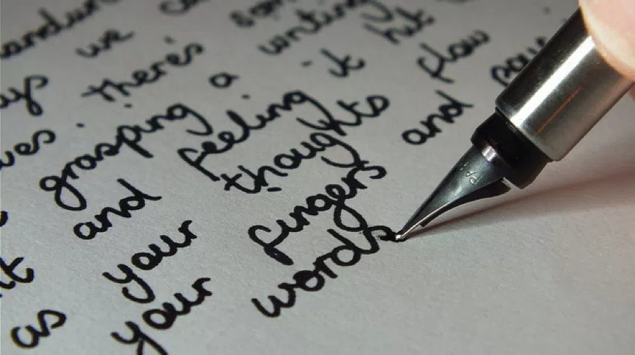
Creative prose
This is the short story.
Students have written a model story in class. They will need to adapt that story for the exam. Do not try and write a new story in the exam
The best way to revise is to:
  Practise writing the story in timed conditions [45 minutes]
  Adapt and rewrite the story to fit as many new titles as possible. There is a list of these in students’ exercise books
  Read as much fiction prose as you can!
Your teacher may be able to sit with you outside of lesson and go through any sample work you have done.

Slide 7
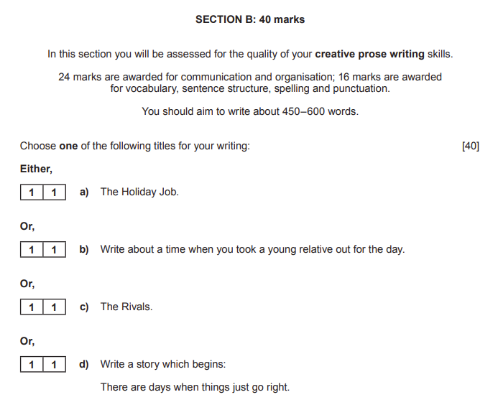
Creative prose – example titles

Slide 8
English literature
Paper 1: Shakespeare (Macbeth) and A Christmas Carol (40% of overall grade)
Paper 2: An Inspector Calls, anthology poetry and unseen poetry (60% of overall grade)
This is the component which will be assessed in the first mock exams

Slide 9

Shakespeare: Macbeth
The best ways to revise are to:
  Use the following sources to familiarise yourself with the plot, characters and themes. Turn these sources into revision materials (flashcards, mind maps, podcasts etc):
    student support pack.
    Sparknotes website https://www.sparknotes.com/shakespeare/macbeth/
    The genius annotations website https://genius.com/albums/William-shakespeare/Macbeth
    Litcharts website (theme tracker function is especially useful) https://www.litcharts.com/lit/macbeth
    Yorknotes revision guide
    exercise books
    annotated copies of the text
  Don’t just read over notes/revision materials. Use them to plan responses to sample questions. Questions will be found in the student support pack.
  Practise the questions in timed conditions. There will be plenty of sample questions in the student support pack.
Your teacher may be able to sit with you outside of lesson and go through any sample work you have done.

Slide 10

A Christmas CArol
The best ways to revise are to:
  Use the following sources to familiarise yourself with the plot, characters and themes. Turn these sources into revision materials (flashcards, mind maps, podcasts etc):
    student support pack
    Sparknotes website https://www.sparknotes.com/lit/christmascarol/
    Genius Website https://genius.com/Charles-dickens-a-christmas-carol-part-1-annotated
    Litcharts website (theme tracker function is especially useful) https://www.litcharts.com/lit/a-christmas-carol
    Yorknotes revision guide
    exercise books
    annotated copies of the text
  Don’t just read over notes/revision materials. Use them to plan responses to sample questions. Questions can be found in the student support pack.
  Practise the questions in timed conditions. There are plenty of sample questions in the student support pack.
Your teacher may be able to sit with you outside of lesson and go through any sample work you have done.

Slide 11
English Language
Revision menu
English Literature
Fiction Reading:
Complete as many sample questions (in timed conditions) as you can from the student support pack.
Creative Prose:
Memorise your story
Adapt it to as many different titles as possible.
Practise the spontaneous planning skills
Shakespeare:
Create revision materials for the plot, characters and themes
Use revision resources to plan responses to sample questions from student support pack
Complete as many sample questions as you can from student support pack.
A Christmas Carol
Create revision materials for the plot, characters and themes
Use revision resources to plan responses to sample questions from student support pack
Complete as many sample questions as you can from student support pack.

Slide 12
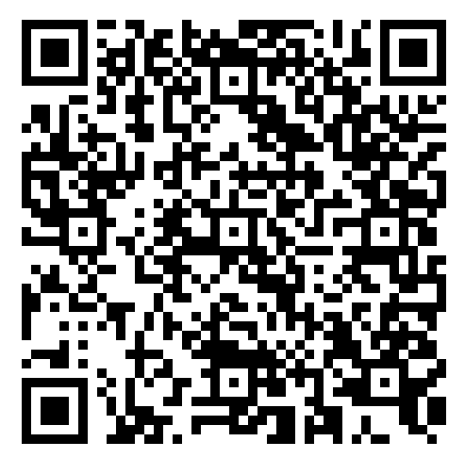
Whitcliffe Mount, A SHARE Academy - English

