Slide 1





Slide 2
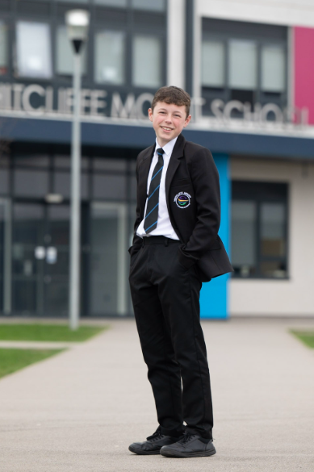
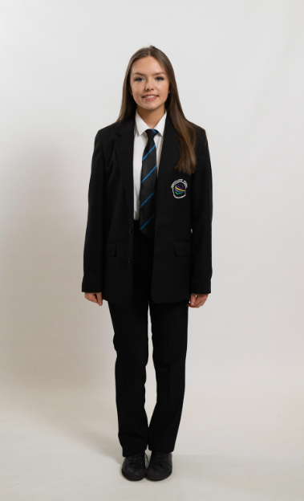
School Uniform
Black School Logo Blazer—Purchased from our Uniform Suppliers.
Black plain, tailored, traditional school trousers.
Black School Shoes—Footwear must be plain black and sensible that can be polished or wiped clean. No logos or sports labels on shoes. No canvas or rubber toe pumps, Vans, Converse, trainers of any kind to be worn.
Students with a medical condition, require a medical note in order to wear alternative footwear. This footwear still needs to be plain black without logos.

Slide 3
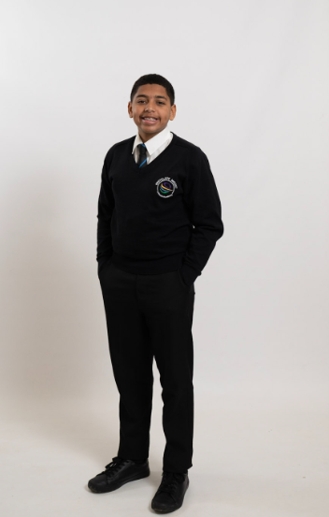
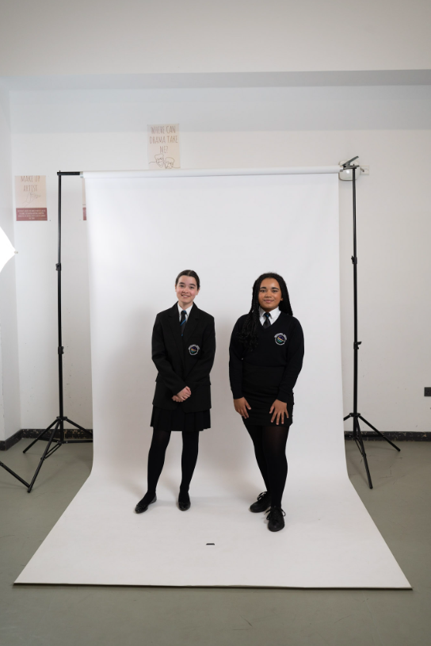
School Uniform
Black School Tie—Year Group Specific—Purchased from our Uniform Suppliers.
White short sleeved shirt/fitted shirt worn in collar and with top button fastened.
Black plain, tailored, traditional school trousers.
Black plain pleated or straight tailored school skirt.
Optional Uniform
Black V-necked School logo Jumper. These are only required in cooler weather and worn under the blazer.

Slide 4
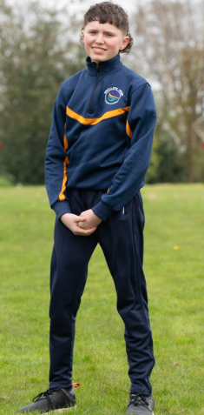
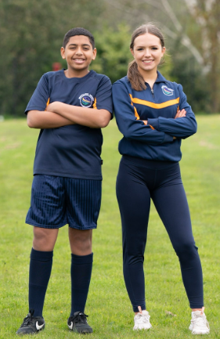
PE kit
School Logo T Shirt – Purchased from our Uniform Suppliers.
Plain Navy shorts - Purchased from our Uniform Suppliers.
Plain Navy Football Socks.
Optional Kit
School Logo ¼ zip Tracksuit top - Purchased from our Uniform Suppliers.
Plain Navy Leggings - Purchased from our Uniform Suppliers.
Plain Navy Tracksuit Bottoms - Purchased from our Uniform Suppliers.

Slide 5
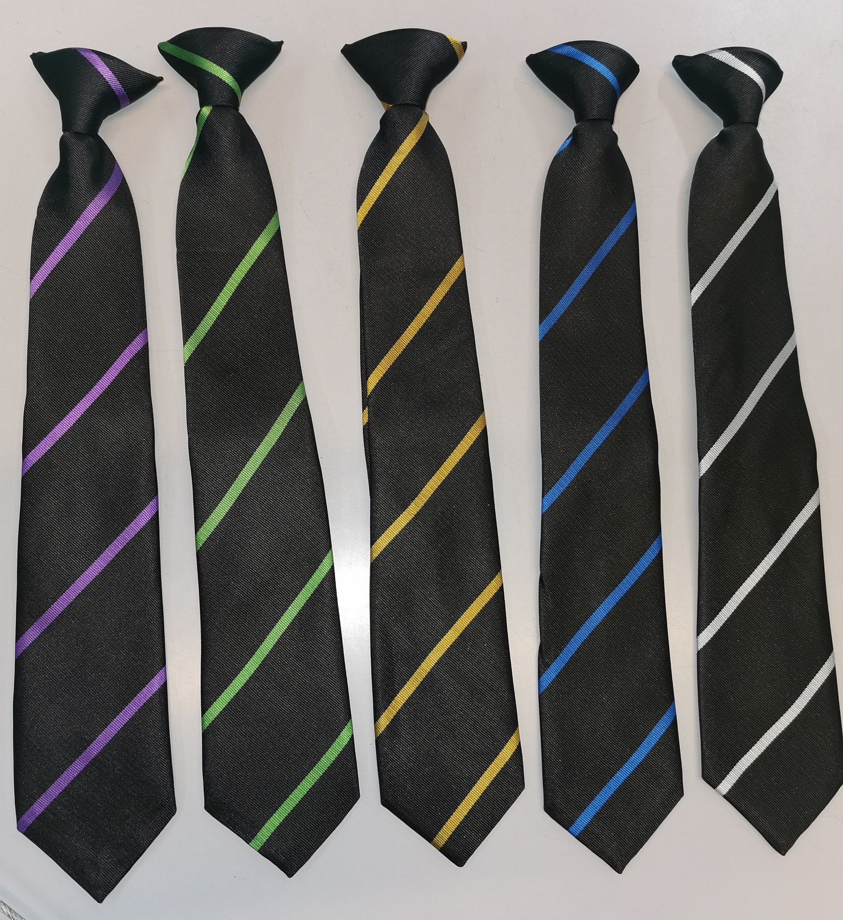
School Ties
Ties are to be worn at all times with the school uniform. They are clip on and will be worn on the top button of a fastened shirt.
Each year group will have their own colour stripe tie which will stay with them throughout their time at Whitcliffe Mount.

Slide 6
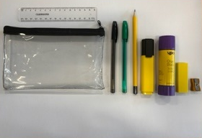
School Equipment
All Students are expected to bring everyday:
School bag (minimum size to hold an A4 Folder)
School Planner
Exercise books in accordance with the timetable
Scientific calculator – Sharp WriteView EL-W531TL
Pencil case containing –
  Black ball point pens
  Green ball points pens
  HB Pencils
  Ruler
  Pencil Sharpener
  Rubber
  Highlighter
  Glue Stick

