Slide 1

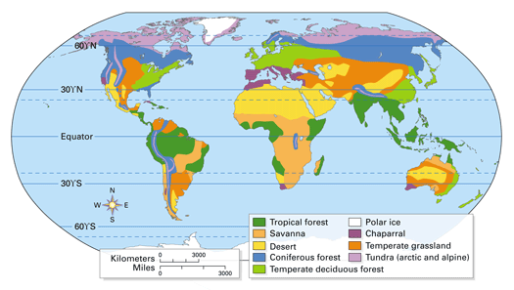
GCSE Geography - Top Tips for Exam Success
Grades 4 – 6
Tip! The most important thing is to have a go at every question!
Tip! Don’t forget to try and use correct Spelling, Punctuation and Grammar (SPaG)!
Tip! Distribution refers to ‘where things are’. The word pattern can be used to describe a regular distribution e.g. ‘it forms a line around the equator’.
When describing distribution or patterns on a map or graph, consider using ‘TEA’:
T – trend - describe the overall pattern or trend
E – example - give a named example such as a place name or figure
A – anomaly - comment on anything that does not fit the pattern. This is called an anomaly.
When looking at anything that has a key e.g. maps and graphs, study the key carefully. it will help you to answer the question. Most maps have a scale and a north arrow. Use them when answering a question.
i
Understand the specification
Paper 1 | Paper 2 | Paper 3
Living with the physical environment: 88 marks (35%), 1hr 30min | Challenges in the human environment: 88 marks (35%), 1hr 30mins | Geographical applications: 76 marks (30%), 1hr 15mins
Challenge of natural hazards: tectonic hazards, tropical storms, extreme weather in the UK, climate change | Urban challenges: global patterns, two contrasting cities, sustainable urban futures | Issue evaluation: critical thinking and problems solving based on pre-release resources booklet, including a decision-making exercise
The living world: local ecosystems, tropical rainforests, one from hot deserts, cold environments – at Whitcliffe we do cold environments | The changing economic world: global patterns, closing the development gap, contrasting studies of economic development (UK and one city in a LIC/NEE) | Fieldwork: general questions based on enquiry process together with questions on the two (physical and human) individual student investigations
Physical landscapes in the UK: two from coastal, river, glacial landscapes – at Whitcliffe we do coasts and river | Challenge of resource management: global resource security, resources in the UK, one from food, water, energy. At Whitcliffe we do food
Reading and deconstructing questions
Read all questions carefully, more than once if you need to. Take time to deconstruct them. In other words, break questions down to help you focus on what exactly is being asked. Consider using BUG: Box the command word Underline words to pick out the geographical focus, any evidence required (e.g. a figure/your own knowledge/case study) and any connections to the geographical focus. You could circle or highlight the connections. Glance back to the question to make sure you include everything in your answer Example: Using Figure 4 and your own knowledge the and impacts of a natural hazard. (6 marks)
Write to the space and time available
Space | Exam papers give you 2 lines per mark. So for a 2 mark question you would have 4 lines Be precise and concise (don’t waffle!)
Time | You have roughly one minute per mark. If you find you are struggling and spending too much time on a question, move on. You can always come back to it later if you have time
social
suggest
economic
Tip! Rather than simply quoting values from a graph, try to manipulate the data so you can make comparisons. E.g. ‘In October, three times more tourists arrived than in June.’
Understanding the marking
 | Point marking | Levels marking
Marks | 1-3 mark questions | 4, 6 and 9 mark questions
Advice | Make precise, accurate points. For 2 and 3 mark questions, try to develop your answer to achieve maximum marks. | Examiners decide if answers belong to Level 1, 2 or 3: Level 1 – basic answer, limited application/knowledge or use of stimulus material (e.g. the ‘figure’ such as a graph, chart, photo, map etc.) Level 2 – clear understanding/application; good use of stimulus material, accurate use of locational information. Clear judgement. Level 3 – thorough/detailed knowledge, understanding and application; coherent (clear) argument; extensive use of examples/case studies and of stimulus material. Well argued judgement.
Tip! Make a simple plan Iin the margin) before starting 6 and 9 mark questions. You could write a list or draw a simple spider diagram

Slide 2
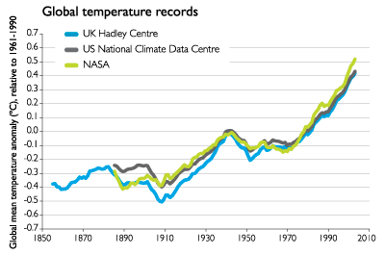

Understand command words (* = most common ones used in exams)
Command word | Typical marks | Meaning | Student advice
* Identify, state, give | 1 | Name, find or give a one word or short statement. | Usually a straightforward question that needs a precise answer – no need for full sentences.
Calculate | 1 or 2 | Work out the value of something. | Double-check your working out. Give the correct units, e.g. kilometres or metres.
Complete | 1 or 2 | Finish the task by adding information. | Double-check you understand the question.
Compare | 2, 3 or 4 | Identify similarities and differences. | Look for similarities and differences. Use words like ‘whereas’ or ‘as opposed to’ when talking about differences.
* Outline | 2 or 4 | State the main characteristics and give an overview. | A brief summary of the key points or characteristics
Describe | 2 or 4 | Give more detailed characteristics. | Write about what you can see. This might include shape, size and colour. Use data if there is some and give highest and lowest values, rates of increase or decrease.
* Explain | 2, 4, 6 or 9 | Give reasons why something happens. | Make a point and give reasons for that point occurring to show your understanding. Use the world ‘because’.
* Suggest | 2, 4, 6 or 9 | Give a possible reason. | Put forward an idea/outcome/judgement/point of view. For longer answers it will require evidence in support.
* To what extent | 6 or 9 | Judge the importance or success of a strategy/scheme/project. | Imagine that a line extends from 0-100%, or yes-no or good-bad. Where is your opinion on that imaginary line, and why? Use words like ‘mostly’, ‘partly’, ‘strongly’ etc. Need to make a judgement.
Assess | 6 or 9 | Weigh up most/least important factors and make a judgement. | Use evidence to judge the level of success, importance or severity of something. Use words like ‘very’, ‘not very’, ‘extremely well’, ‘poorly’ etc. Need to make a judgement.
Evaluate | 9 | Give both sides of an argument e.g. good and bad points, advantages/disadvantages. | Use evidence to weigh up and make judgements. Often to do with how successful or effective something is. Use words like ‘whereas’ or ‘on the other hand’. Need to make a judgement.
Discuss | 6 or 9 | Present key points about different ideas or strengths and weaknesses of an idea. | Make a balanced argument including both sides – pros and cons, advantages and disadvantages. Use words like ‘whereas’ or ‘however’.
Justify | 9 | Support a case or decision using evidence. | Back up your views with evidence.
Tip! If there are words in a question you do not understand, don’t panic! Cross out those you don’t understand and have a go at what is left. You can still pick up some marks. E.g. ‘Explain how river flooding can have social and economic impacts on communities.’ (4 marks)
Now you can focus on general impacts and chances are you will include some social and economic.
Case Study Tips!
Try to learn around four specific facts or figures for each case study.
Case studies and examples are most likely to be required in 6 or 9 mark questions.
When a question refers to a place ‘you have studied’ then you must refer to a specific place or event e.g. Bristol, Lagos, Nepal and Chile earthquakes etc.
Tip! Even if a question doesn’t ask for specific information about an event or place you should still use examples whenever you can e.g. ‘Mount Tambora’ when talking about natural causes of climate change or ‘oil in Nigeria’ when talking about development.
Tip! When a question asks you use a figure, example, graph, case study etc. you could start your answer with those words e.g. ‘Figure 2 shows…’. This ensures you use the information – if you don’t, you won’t gain full marks!
Tip! When asked to use a photo in a question, consider drawing circles directly onto photos, or writing detailed labels (annotations) to pick out key features.
Tip! Where a question says ‘using your own knowledge’, usually alongside a figure, then make sure you try and include what you know, in order to achieve more marks.
Look after yourself!
Plan your revision. You could make a revision timetable. Revise in 40 minute sessions and take breaks in between. Exercise! It’s good for mind and body! Eat well and drink plenty of water. You will be able to think more clearly. Get plenty of sleep and leave social media alone for a while!

